Slide 1


A Warm Welcome to our Presentation
Slides can be found at
https://is.gd/stiff
A question earns a contributor badge in our GitHub Repo 🎉

Slide 2
Numerical Approaches for Solving (Stiff) Differential Equations
Introduction to basic and commonly used methods and their limitations.
Seminar talk in the Scientific Machine Learning Seminar by Dr. Tobias Buck, AstroAI-Lab
Heidelberg University, Department for Physics and Astronomy
by Daniel Richter and Leonard Storcks, 23.05.2023

Slide 3
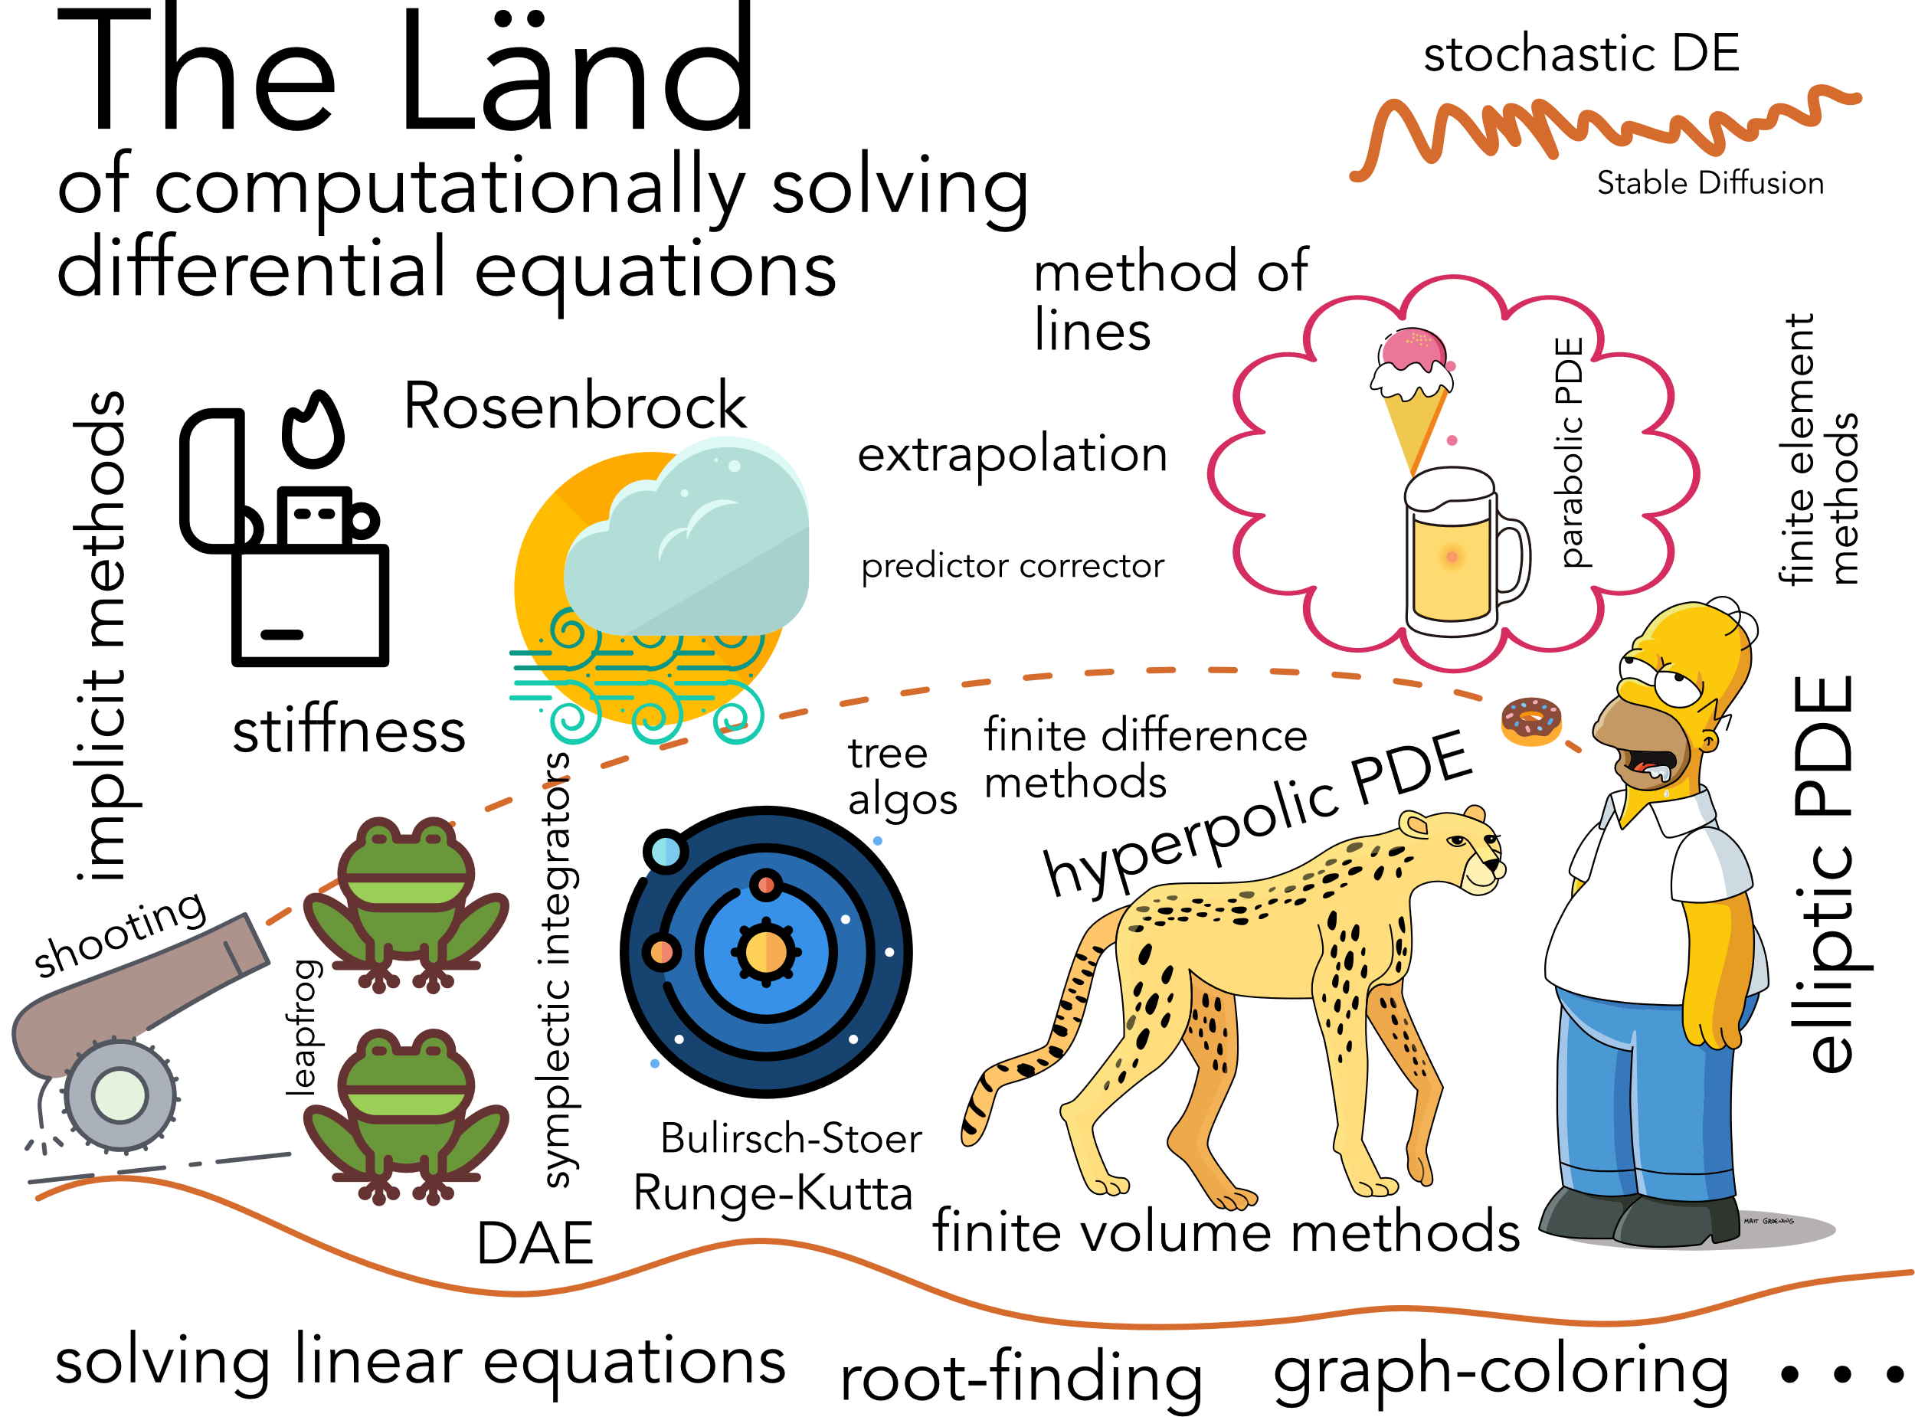
It’s big.

Slide 4
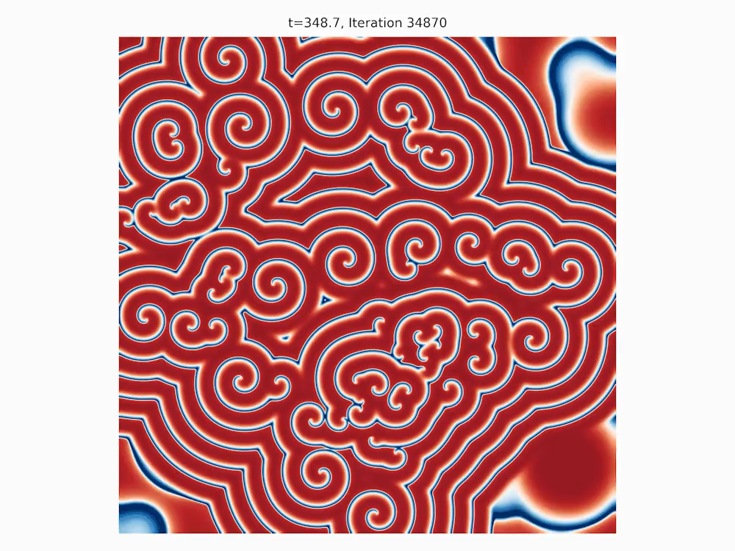
Motivation
A beautiful oscillatory system involving chemistry and diffusion
the Brusselator.
… and its stiff
Source:
H-Psi-is-E-Psi, Brusselator Oscillations HQ Render, CC BY-SA 4.0
Notes:
Ok but why do we look at such beautiful differential equations in a Scientific Machine Learning Seminar?

Slide 5
Context of SciML
»Scientific machine learning is the burgeoning field combining techniques of machine learning into traditional scientific computing and mechanistic modeling.« [e. g. Zubov et al, 2021]
Automatic Differentiation
Solving Linear Equations
Computationally Solving Differential Equations
…
Graph coloring
Krylov subspaces
Notes:
Ok but why do we talk about numerically solving differential equations in a machine learning seminar?. . One particular quote one might come upon quite often when researching about scientific machine learning in general. Quote. Topics all over the field of mathematics

Slide 6
Table of Contents
Some Classical Methods for Solving ODEs
The Problem of Conserved Quantities
The Problem of Stiffness
Efficiently Solving Stiff ODEs
Breakdown of Classical Methods & Outlook
Key insights to take away
main part

Slide 7
Some Classical Methods for Solving ODEs

Slide 8
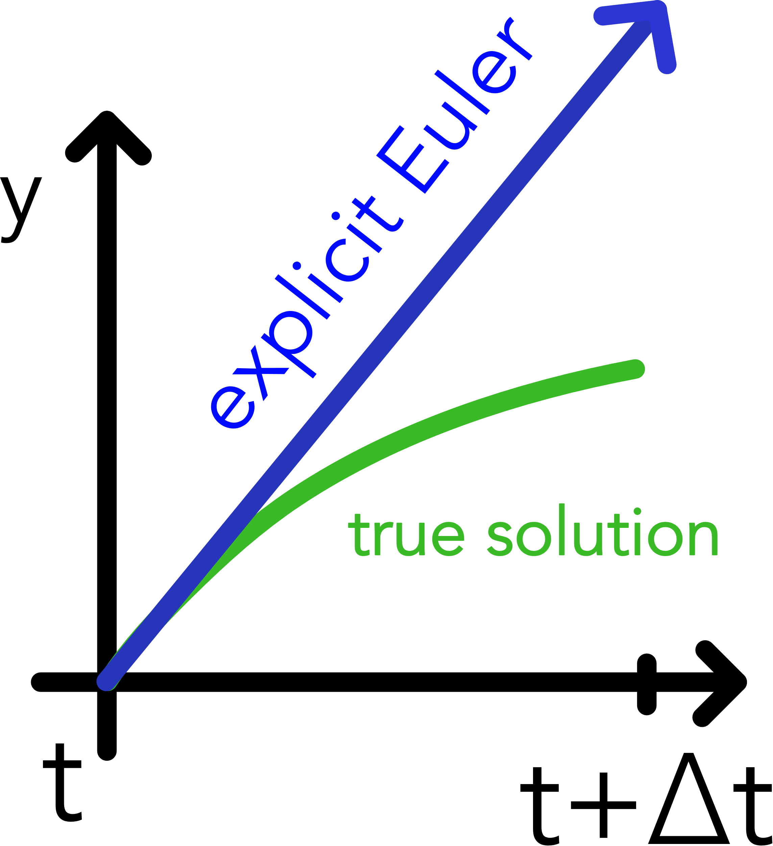
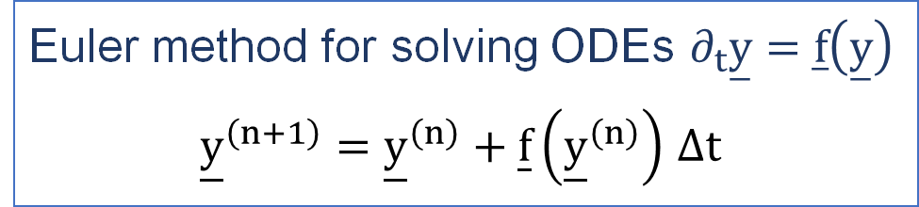
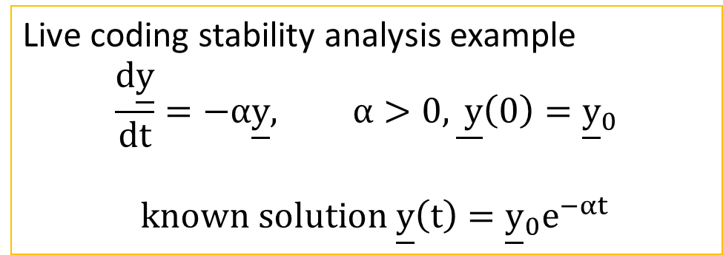
Explicit Euler Method
Euler method for solving ODEs $∂_{t}\overset{̲}{y}=\overset{̲}{f}\left(\overset{̲}{y}\right)$
${\underline{y}}^{\left(n+1\right)}={\underline{y}}^{\left(n\right)}+\underline{f}\left({\underline{y}}^{\left(n\right)}\right)$ $Δt$
Live coding stability analysis example
$$\frac{d\underline{y}}{dt}=−α\underline{y}, α>0, \underline{ y}\left(0\right)={\underline{y}}_{0}$$
$$known solution \underline{y}\left(t\right)={\underline{y}}_{0}e^{−αt}$$
Some Classical Methods | Problem of Conserved Quantities | Problem of Stiffness | Efficiently Solving Stiff ODEs
Notes:
Maybe a more visual explanation. So, how would we calculate the next position. POINT, take the value of our current position and the slope at this position times timestep. That‘s all there is

Slide 9
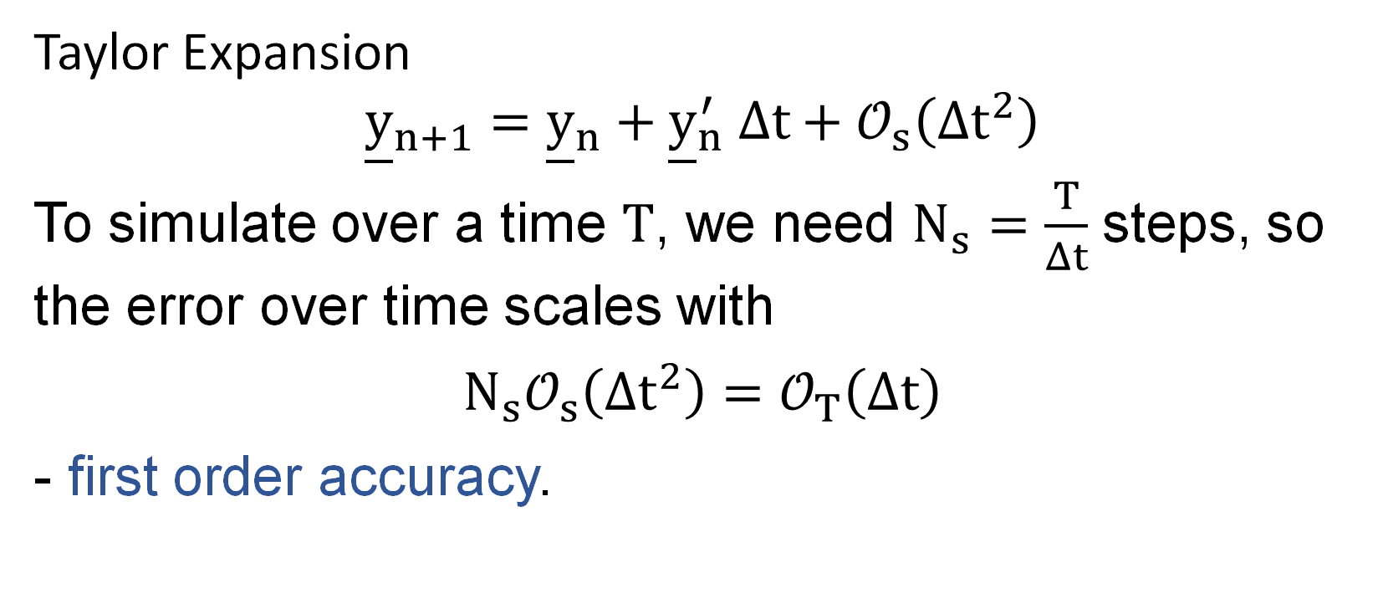
What is the Order of Explicit Euler?
Taylor Expansion
$${\underline{y}}_{n+1}={\underline{y}}_{n}+{\underline{y}}_{n}^{′} Δt+𝒪_{s}\left(Δt^{2}\right)$$
To simulate over a time $T$, we need $N_{s}=\frac{T}{Δt}$ steps, so the error over time scales with
$$N_{s}𝒪_{s}\left(Δt^{2}\right)=𝒪_{T}\left(Δt\right)$$
- first order accuracy.
Some Classical Methods | Problem of Conserved Quantities | Problem of Stiffness | Efficiently Solving Stiff ODEs
Notes:
Keep it simple, to find the order we can look at the taylor expansion, order in each step is 2. => time region has first order accuracy

Slide 10
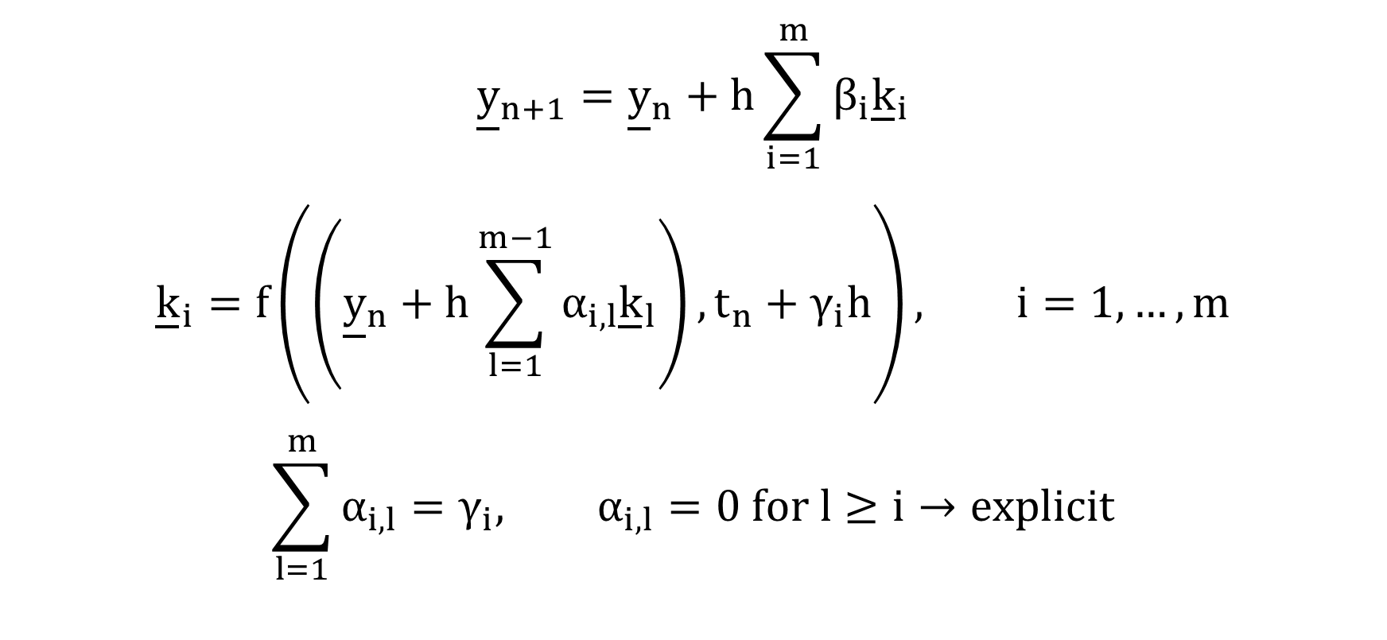
Runge-Kutta-Method
Q: How would you construct a higher order scheme?
Runge-Kutta Idea: Weighted combination of simple derivatives
$${\underline{y}}_{n+1}={\underline{y}}_{n}+h\sum_{i=1}^{m}{β_{i}{\underline{k}}_{i}}$$
$${\underline{k}}_{i}=f\left(\left({\underline{y}}_{n}+h\sum_{l=1}^{m−1}{α_{i,l}{\underline{k}}_{l}}\right),t_{n}+γ_{i}h\right), i=1,…,m$$
$$\sum_{l=1}^{m}{α_{i,l}}=γ_{i}, α_{i,l}=0 for l≥i→explicit$$
Some Classical Methods | Problem of Conserved Quantities | Problem of Stiffness | Efficiently Solving Stiff ODEs
Notes:
What about higher orders ? General formula

Slide 11
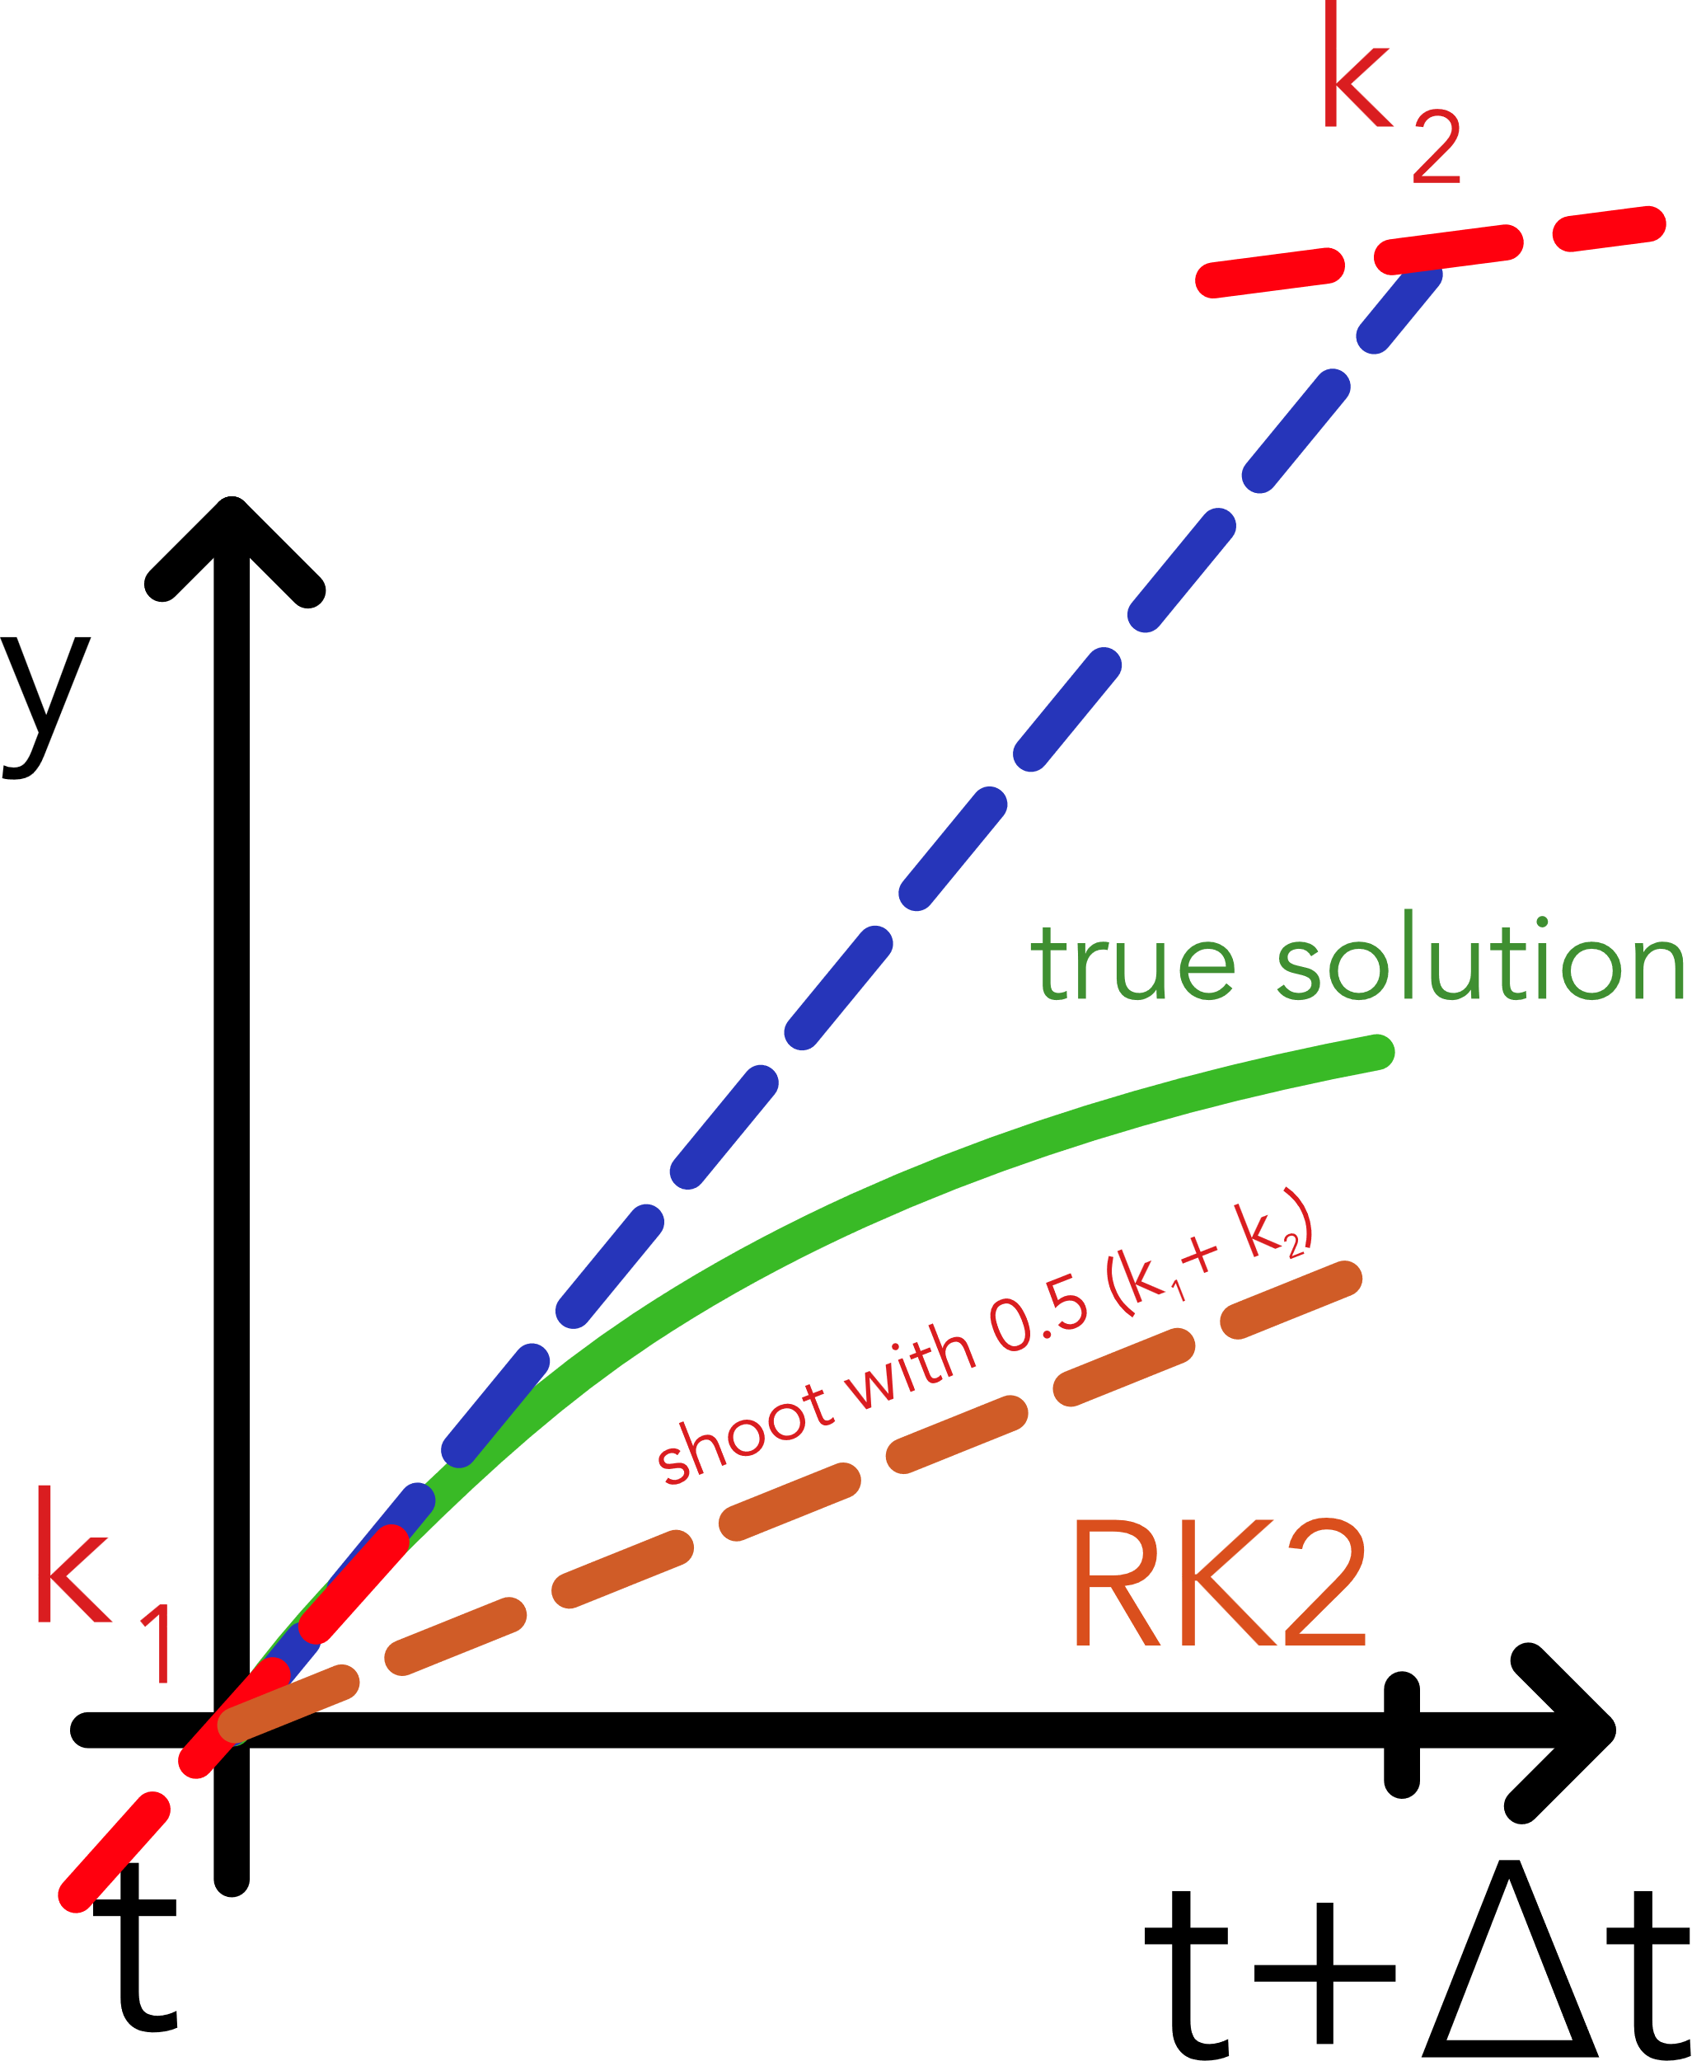
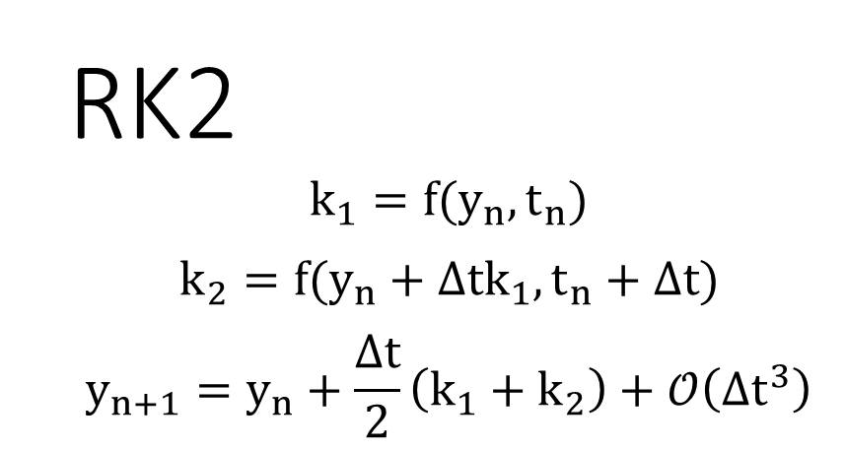
RK2
$$k_{1}=f(y_{n},t_{n})$$
$$k_{2}=f(y_{n}+Δtk_{1},t_{n}+Δt)$$
$$y_{n+1}=y_{n}+\frac{Δt}{2}\left(k_{1}+k_{2}\right)+𝒪\left({Δt}^{3}\right)$$
Outlook on further RK methods
e. g. RK Fehlberg 4/5 with included error estimation
Some Classical Methods | Problem of Conserved Quantities | Problem of Stiffness | Efficiently Solving Stiff ODEs
Notes:
To calculate next step, we begin with k1, for that we take derivative at current position. Next To calculate k2, take derivative at t (so k1), shoot out by dt and calculate derivative at new position. Finally take average of both slopes and calculate the step

Slide 12
The Problem of Conserved Quantities
Notes:
Let’s consider the two body problem, simulating the motion of the earth orbiting around the sun

Slide 13
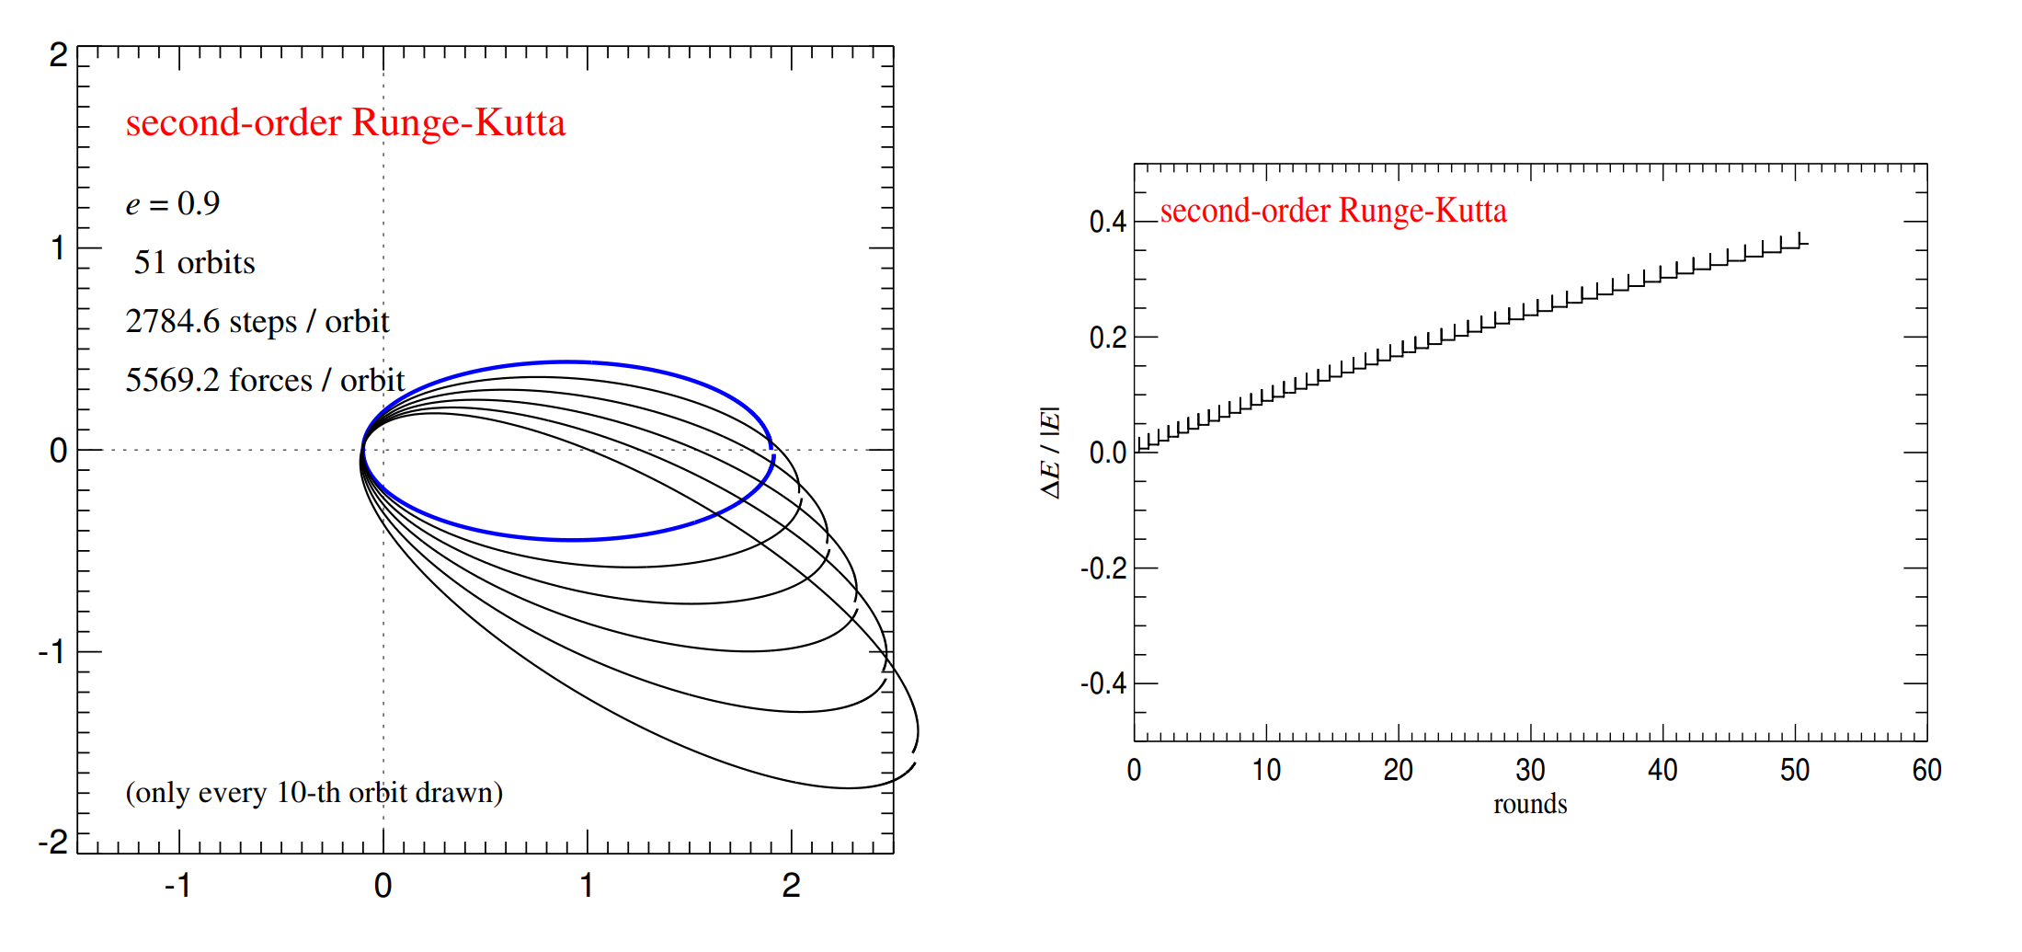
Solution of the two-body Problem
Energy error in each step!
[from the Fundamentals of Simulation Methods lecture notes by Springel et al., version 2022/2023]
Some Classical Methods | Problem of Conserved Quantities | Problem of Stiffness | Efficiently Solving Stiff ODEs

Slide 14
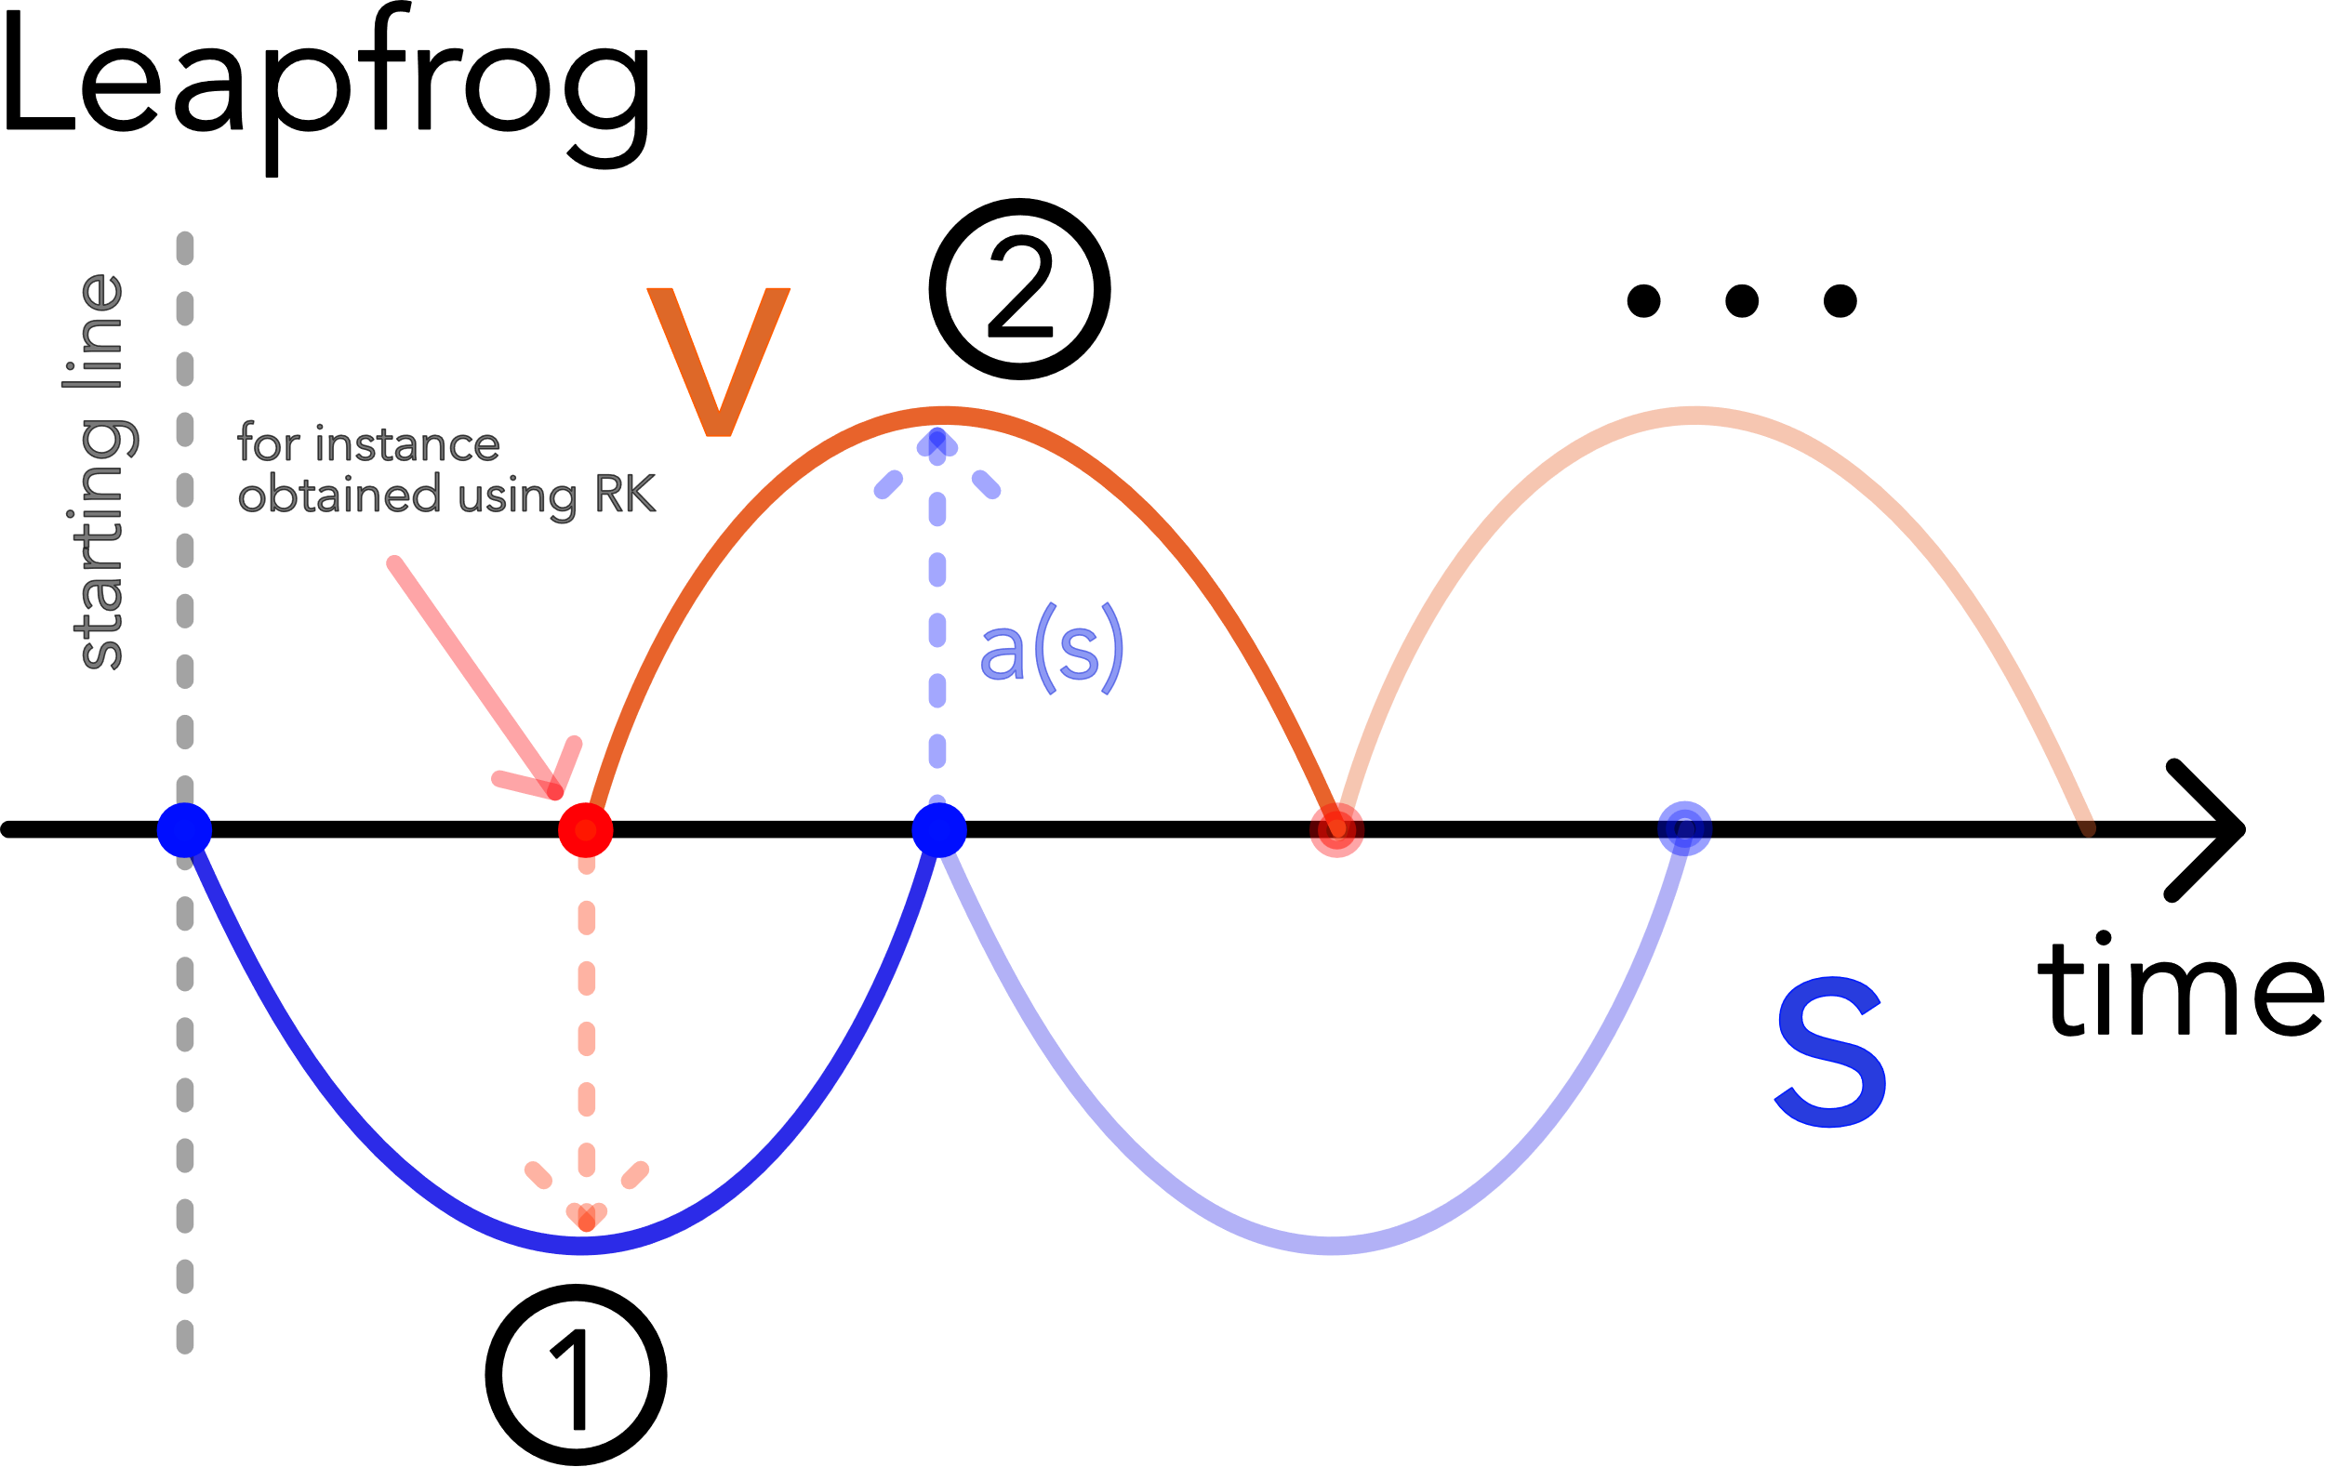
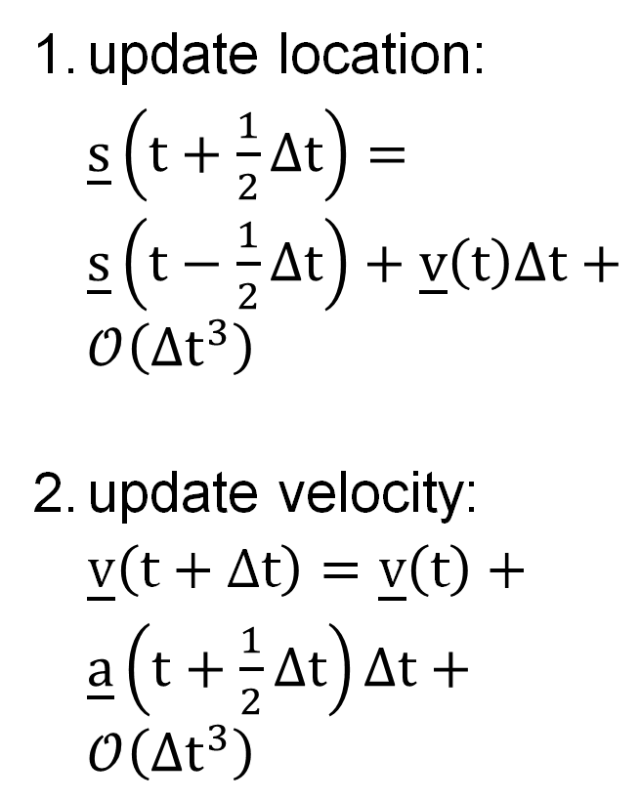
update location: $\underline{s}\left(t+\frac{1}{2}Δt\right)=\underline{s}\left(t−\frac{1}{2}Δt\right)+\underline{v}\left(t\right)Δt+𝒪\left(Δt^{3}\right)$
update velocity: $\underline{v}\left(t+Δt\right)=\underline{v}\left(t\right)+\underline{a}\left(t+\frac{1}{2}Δt\right)Δt+𝒪\left(Δt^{3}\right)$
Symplectic integrator with good energy conservation properties; time reversibility; exact angular momentum conservation
Some Classical Methods | Problem of Conserved Quantities | Problem of Stiffness | Efficiently Solving Stiff ODEs
Notes:
Split integration into two steps, first on every half integer step we update the location. On every full integer step update the velocity .... Why do we assume this to work better, because leapfrog is a symplectic integrator

Slide 15
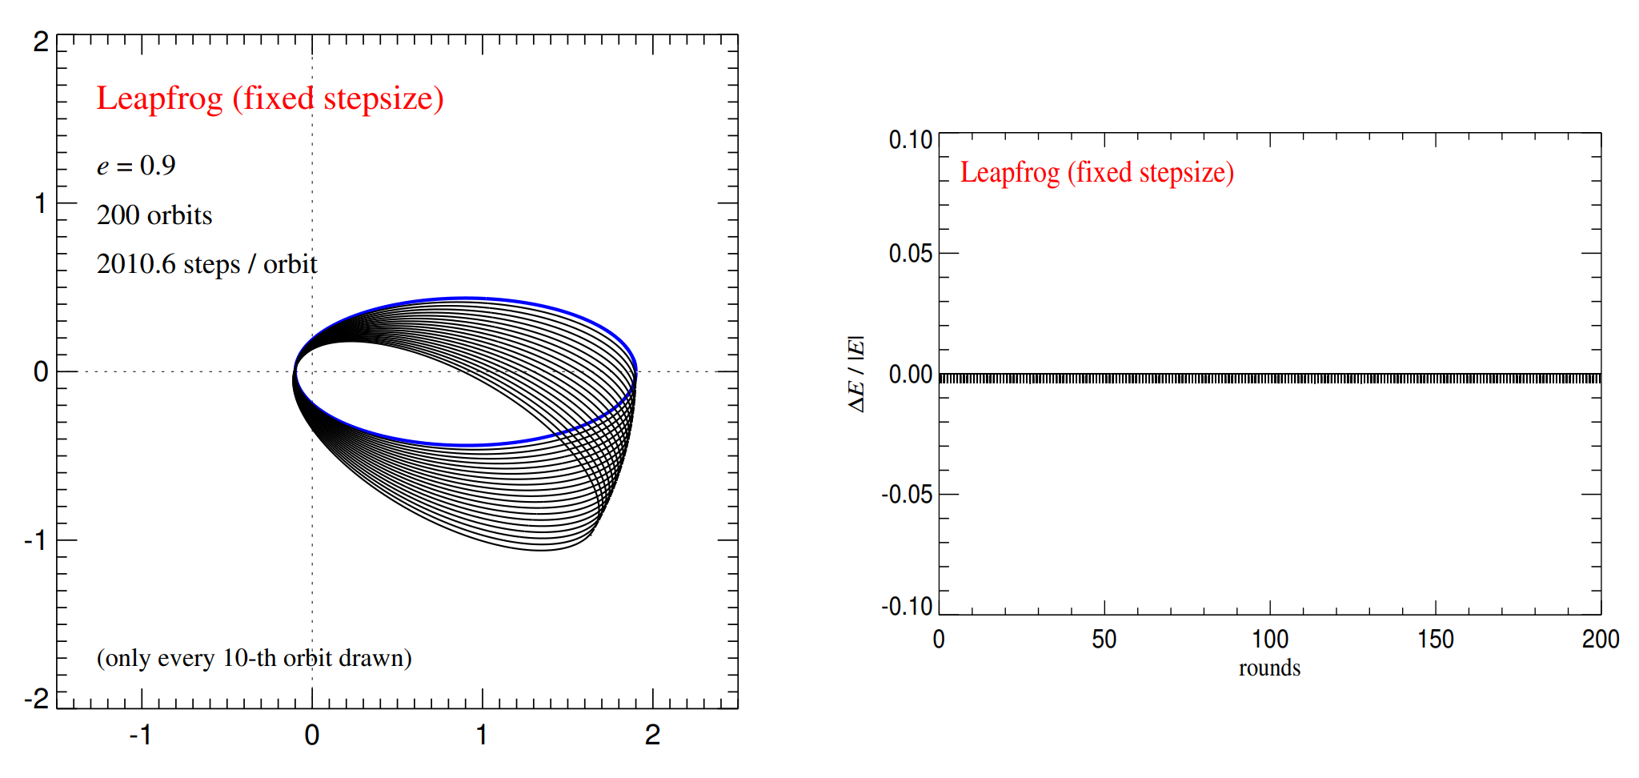
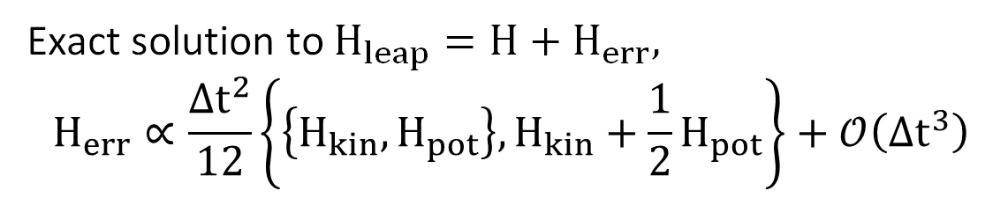
Exact solution to $H_{leap}=H+H_{err},$ $$H_{err}∝\frac{Δt^{2}}{12}\left\{\left\{H_{kin},H_{pot}\right\},H_{kin}+\frac{1}{2}H_{pot}\right\}+𝒪\left(Δt^{3}\right)$$
[from the “Fundamentals of Simulation Methods” lecture notes by Springel et al., version 2022/2023]
Some Classical Methods | Problem of Conserved Quantities | Problem of Stiffness | Efficiently Solving Stiff ODEs

Slide 16
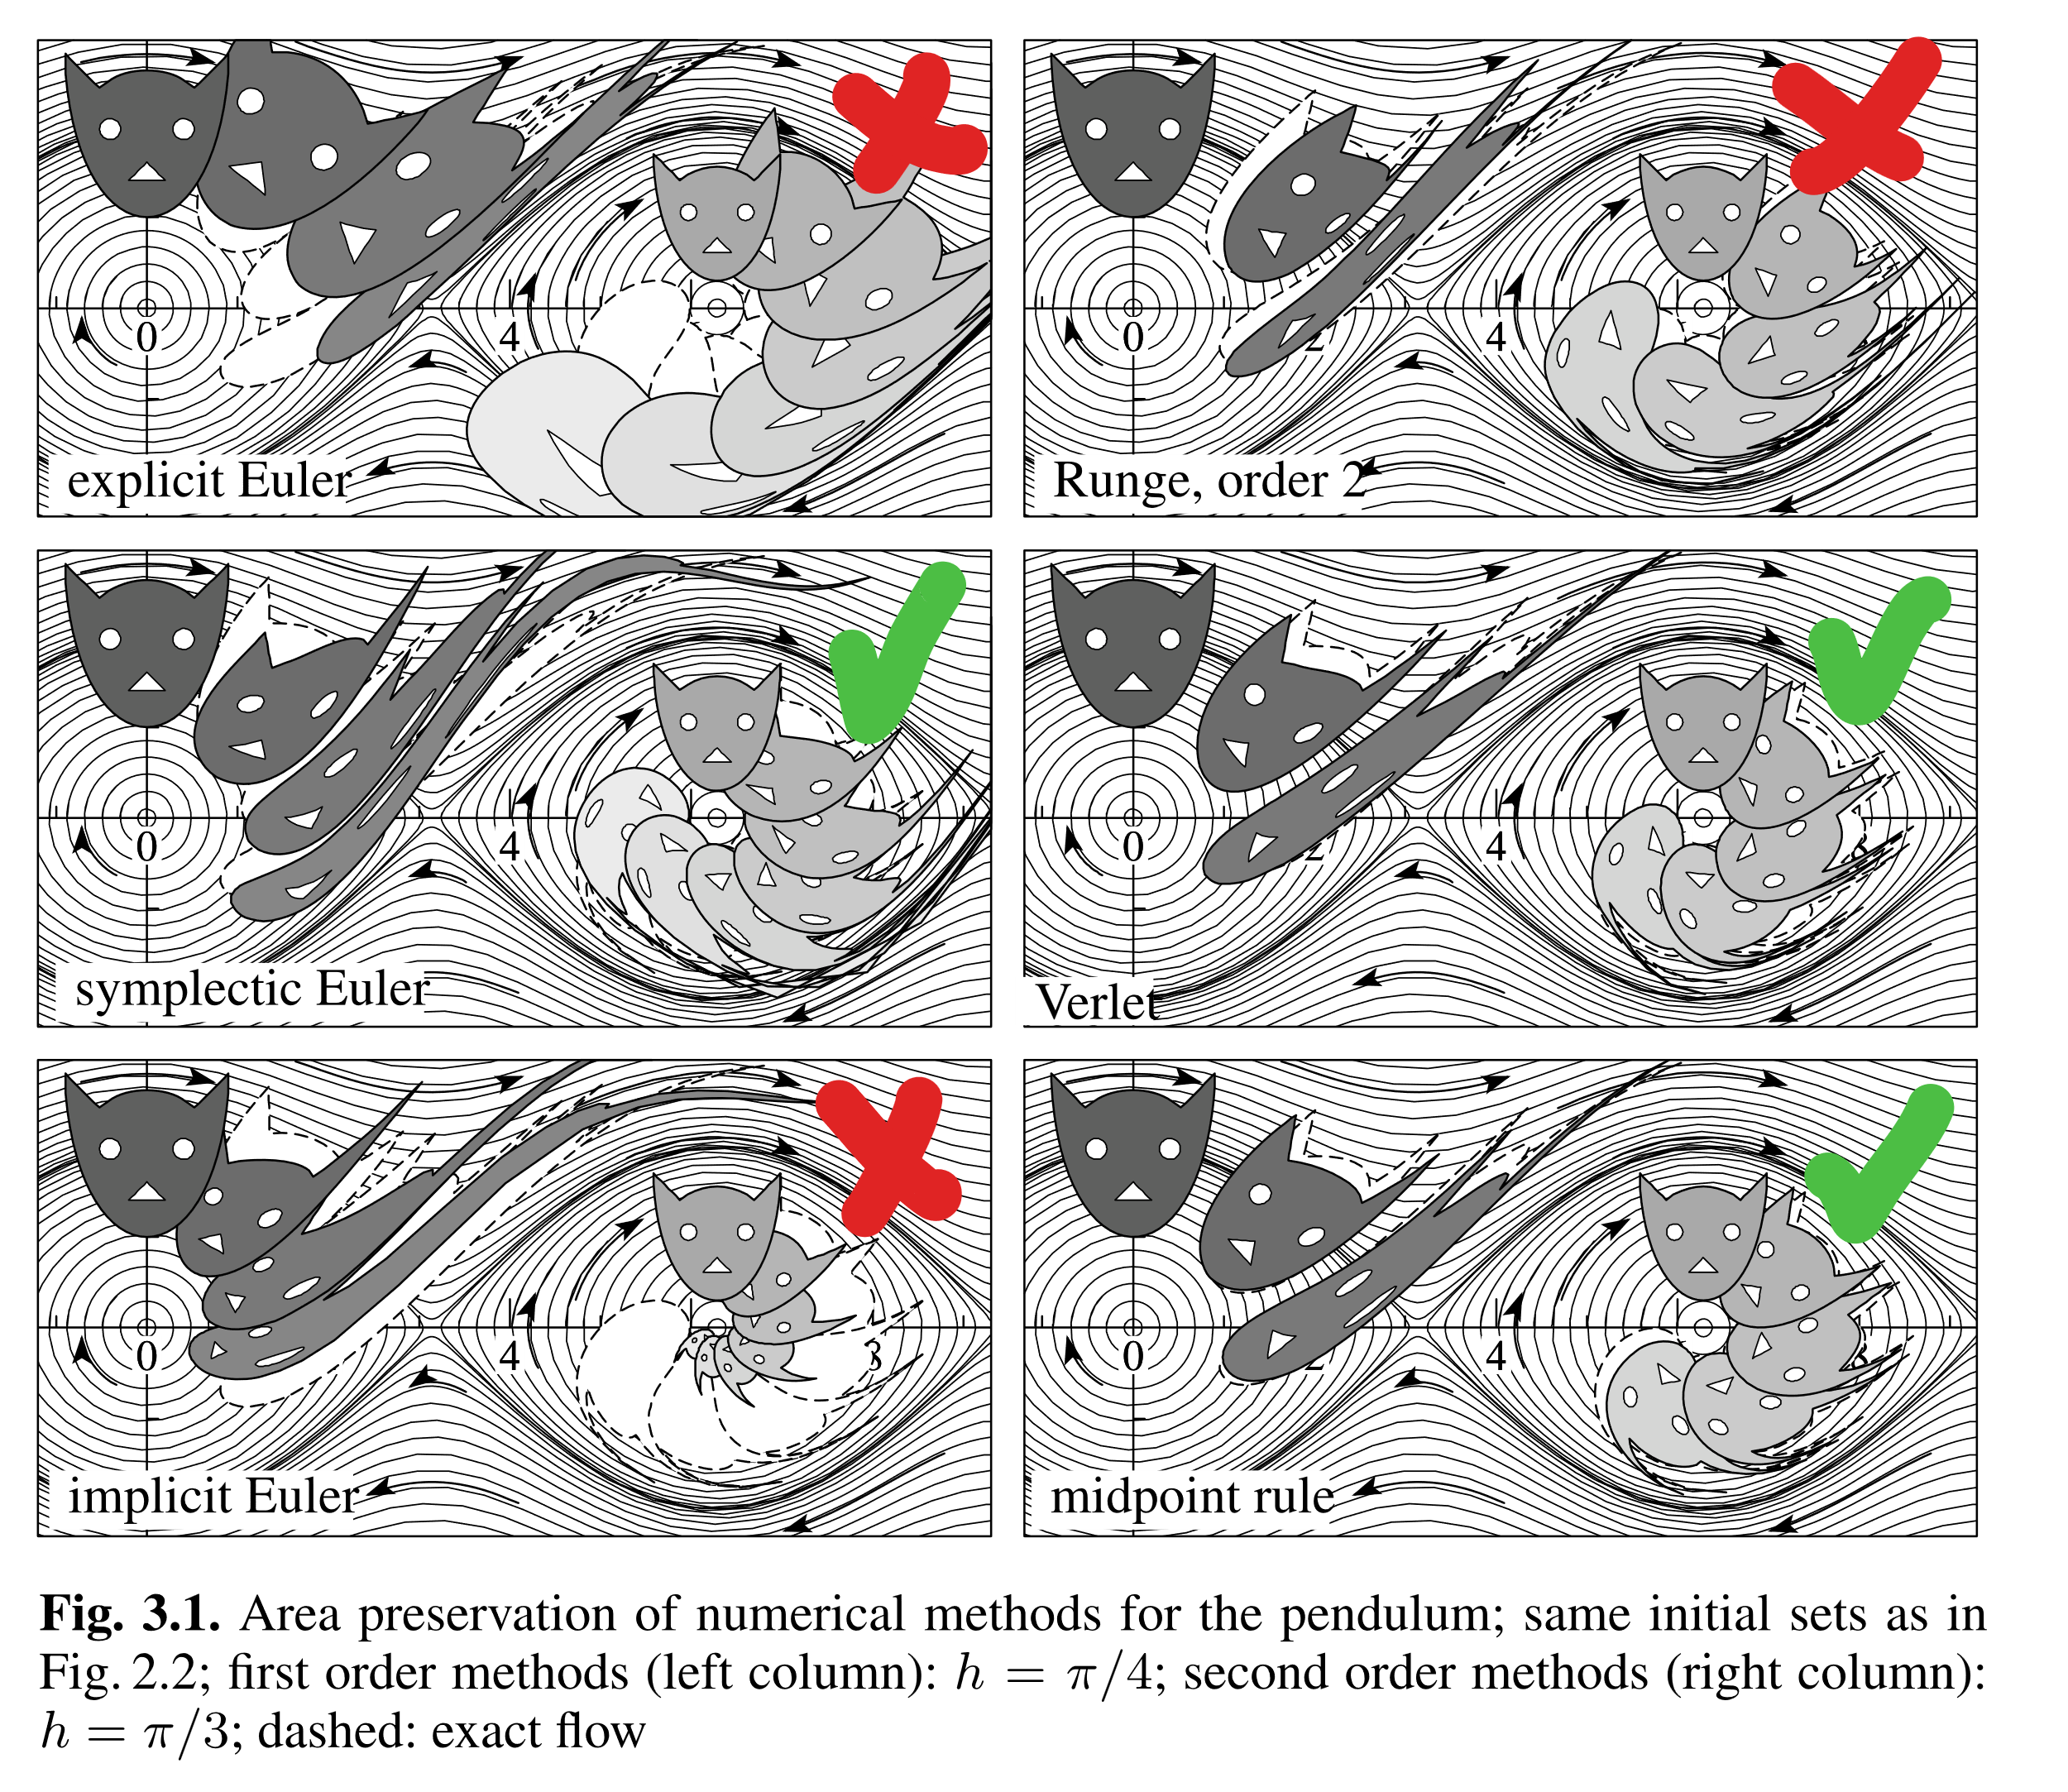
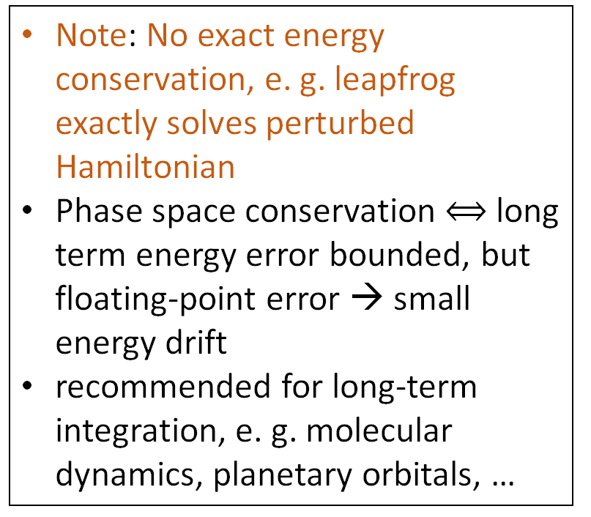
Intuition of Symplecticity in 2D
A symplectic transformation is area preserving.
Note: No exact energy conservation, e. g. leapfrog exactly solves perturbed Hamiltonian
Phase space conservation $⟺$ long term energy error bounded, but floating-point error → small energy drift
recommended for long-term integration, e. g. molecular dynamics, planetary orbitals, …
[from chapter 6 in “Geometrical Numerical Integration”, Hairer, Lubich, Wanner, 2005]
Some Classical Methods | Problem of Conserved Quantities | Problem of Stiffness | Efficiently Solving Stiff ODEs

Slide 17
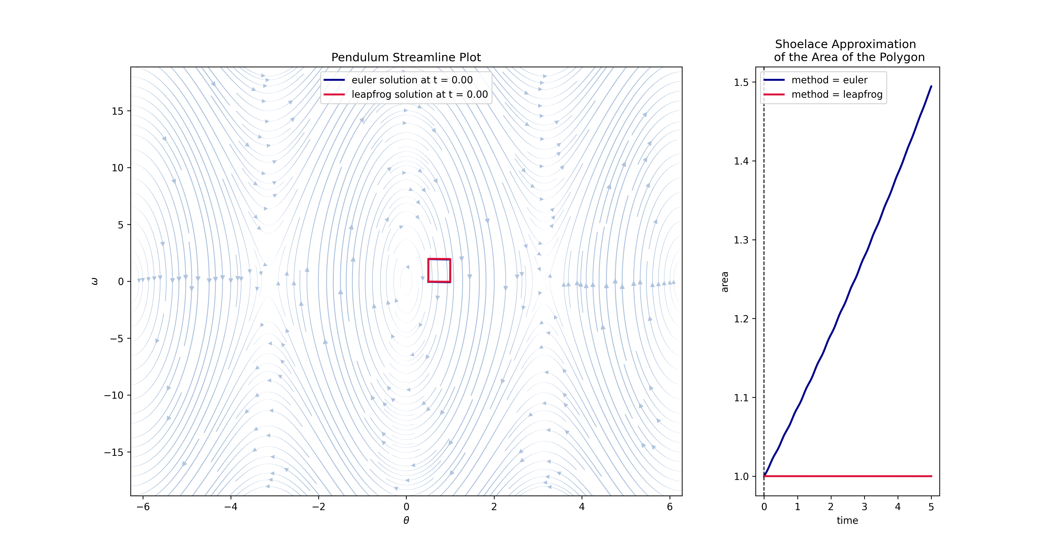
(leapfrog in kick-drift-kick scheme)
Some Classical Methods | Problem of Conserved Quantities | Problem of Stiffness | Efficiently Solving Stiff ODEs
Notes:
A more visual example for explaination. This is a depiction of phase space of a mechanical pendulum

Slide 18
The Problem of Stiffness

Slide 19
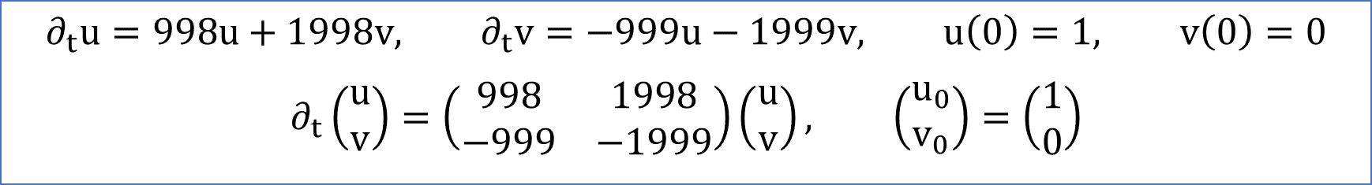
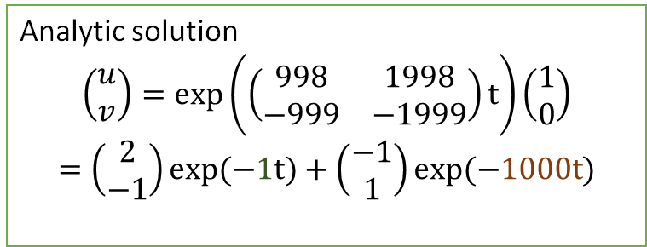
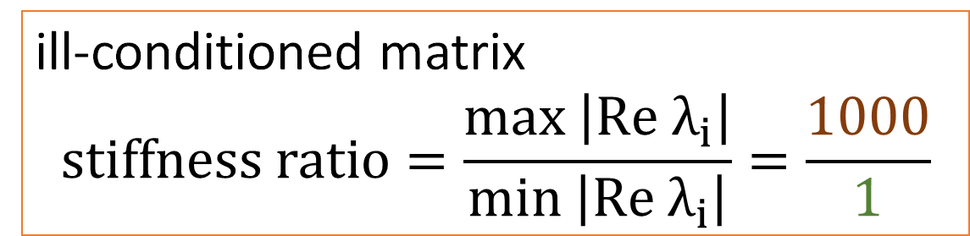
Linear ODE example
$$∂_{t}u=998u+1998v, ∂_{t}v=−999u−1999v, u\left(0\right)=1, v\left(0\right)=0$$
$$∂_{t}\left(\begin{aligned}u \\ v\end{aligned}\right)=\left(\begin{matrix}998 & 1998 \\ −999 & −1999\end{matrix}\right)\left(\begin{aligned}u \\ v\end{aligned}\right), \left(\begin{aligned}u_{0} \\ v_{0}\end{aligned}\right)=\left(\begin{aligned}1 \\ 0\end{aligned}\right)$$
Analytic solution
$$\left(\begin{aligned}&u \\ &v\end{aligned}\right)=\exp\left(\left(\begin{matrix}998 & 1998 \\ −999 & −1999\end{matrix}\right)t\right)\left(\begin{aligned}&1 \\ &0\end{aligned}\right)$$
$$=\left(\begin{matrix}2 \\ −1\end{matrix}\right)\exp{(−1t)}+\left(\begin{matrix}−1 \\ 1\end{matrix}\right)\exp{(−1000t)}$$
ill-conditioned matrix
$$stiffness ratio=\frac{\max\left|Re λ_{i}\right|}{\min\left|Re λ_{i}\right|}=\frac{1000}{1}$$
decay on vastly different time-scales
Example from the
“Numerical Recipes” book
Some Classical Methods | Problem of Conserved Quantities | Problem of Stiffness | Efficiently Solving Stiff ODEs
Notes:
Consider these two linear equations, … rewrite into linear system of eq, represent in matrix form , analytical solution, eigenvectors, decaying term on a large and rapid decay on small timescale. Why is this problem now considered stiff
All eigenvalues have negative real part (important) and stiffness ratio is large.
But stiffness can also occur for cases where there are positive eigenvalues

Slide 20
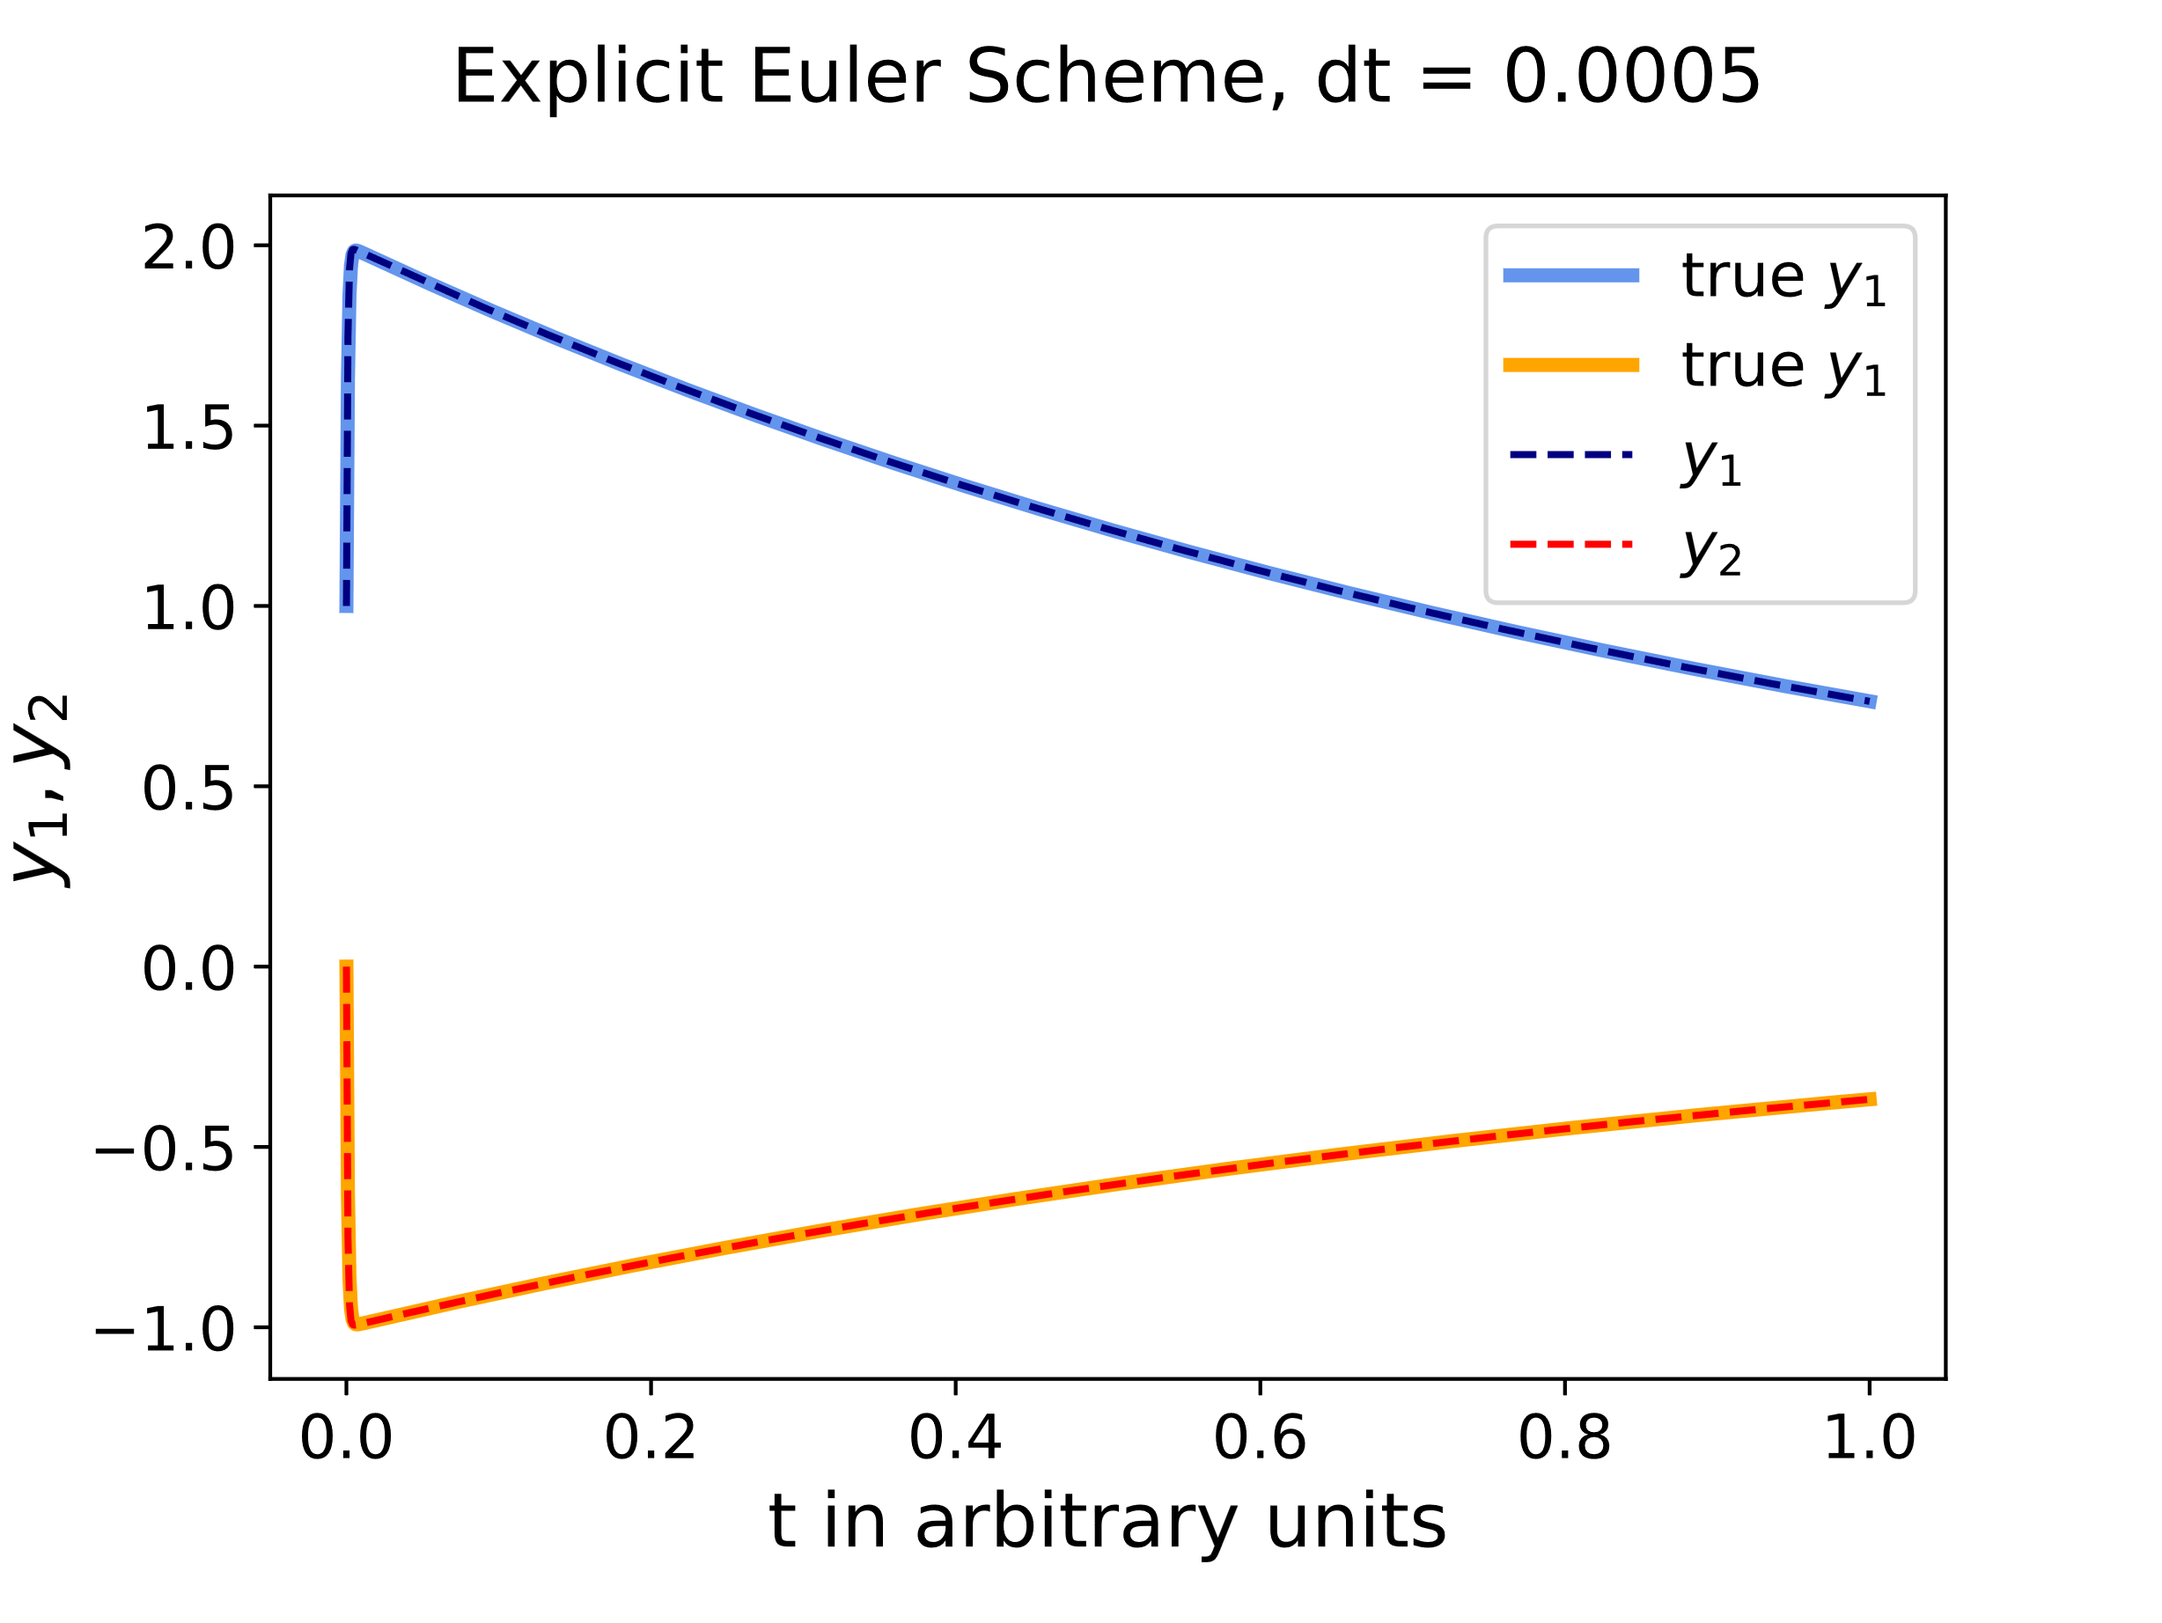
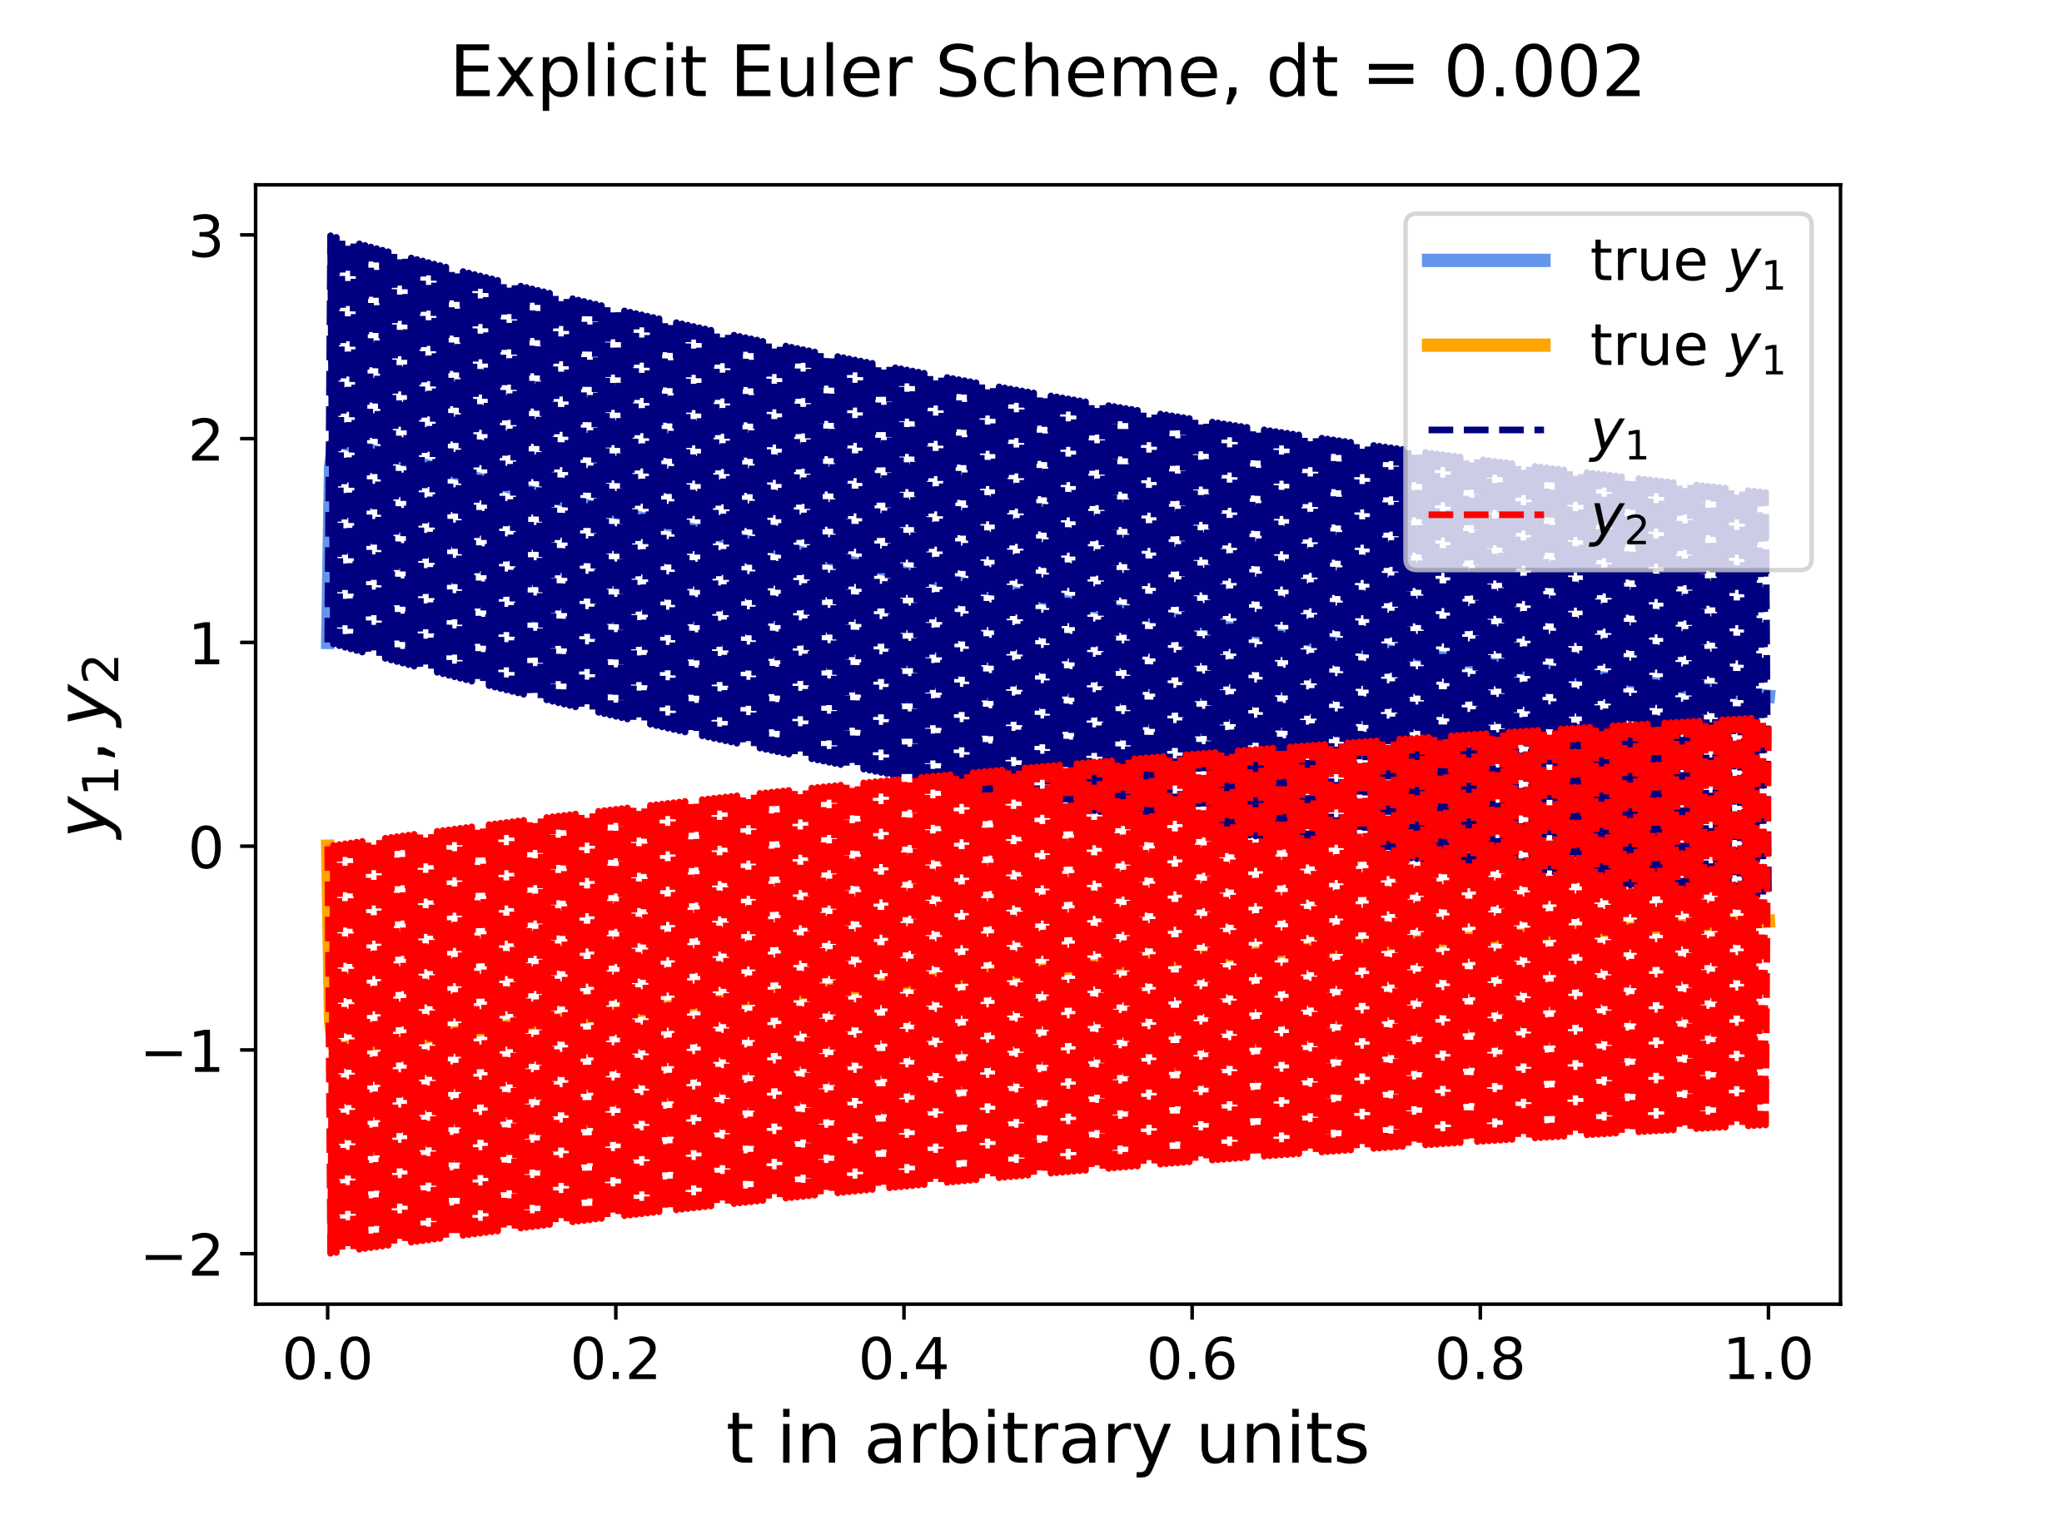
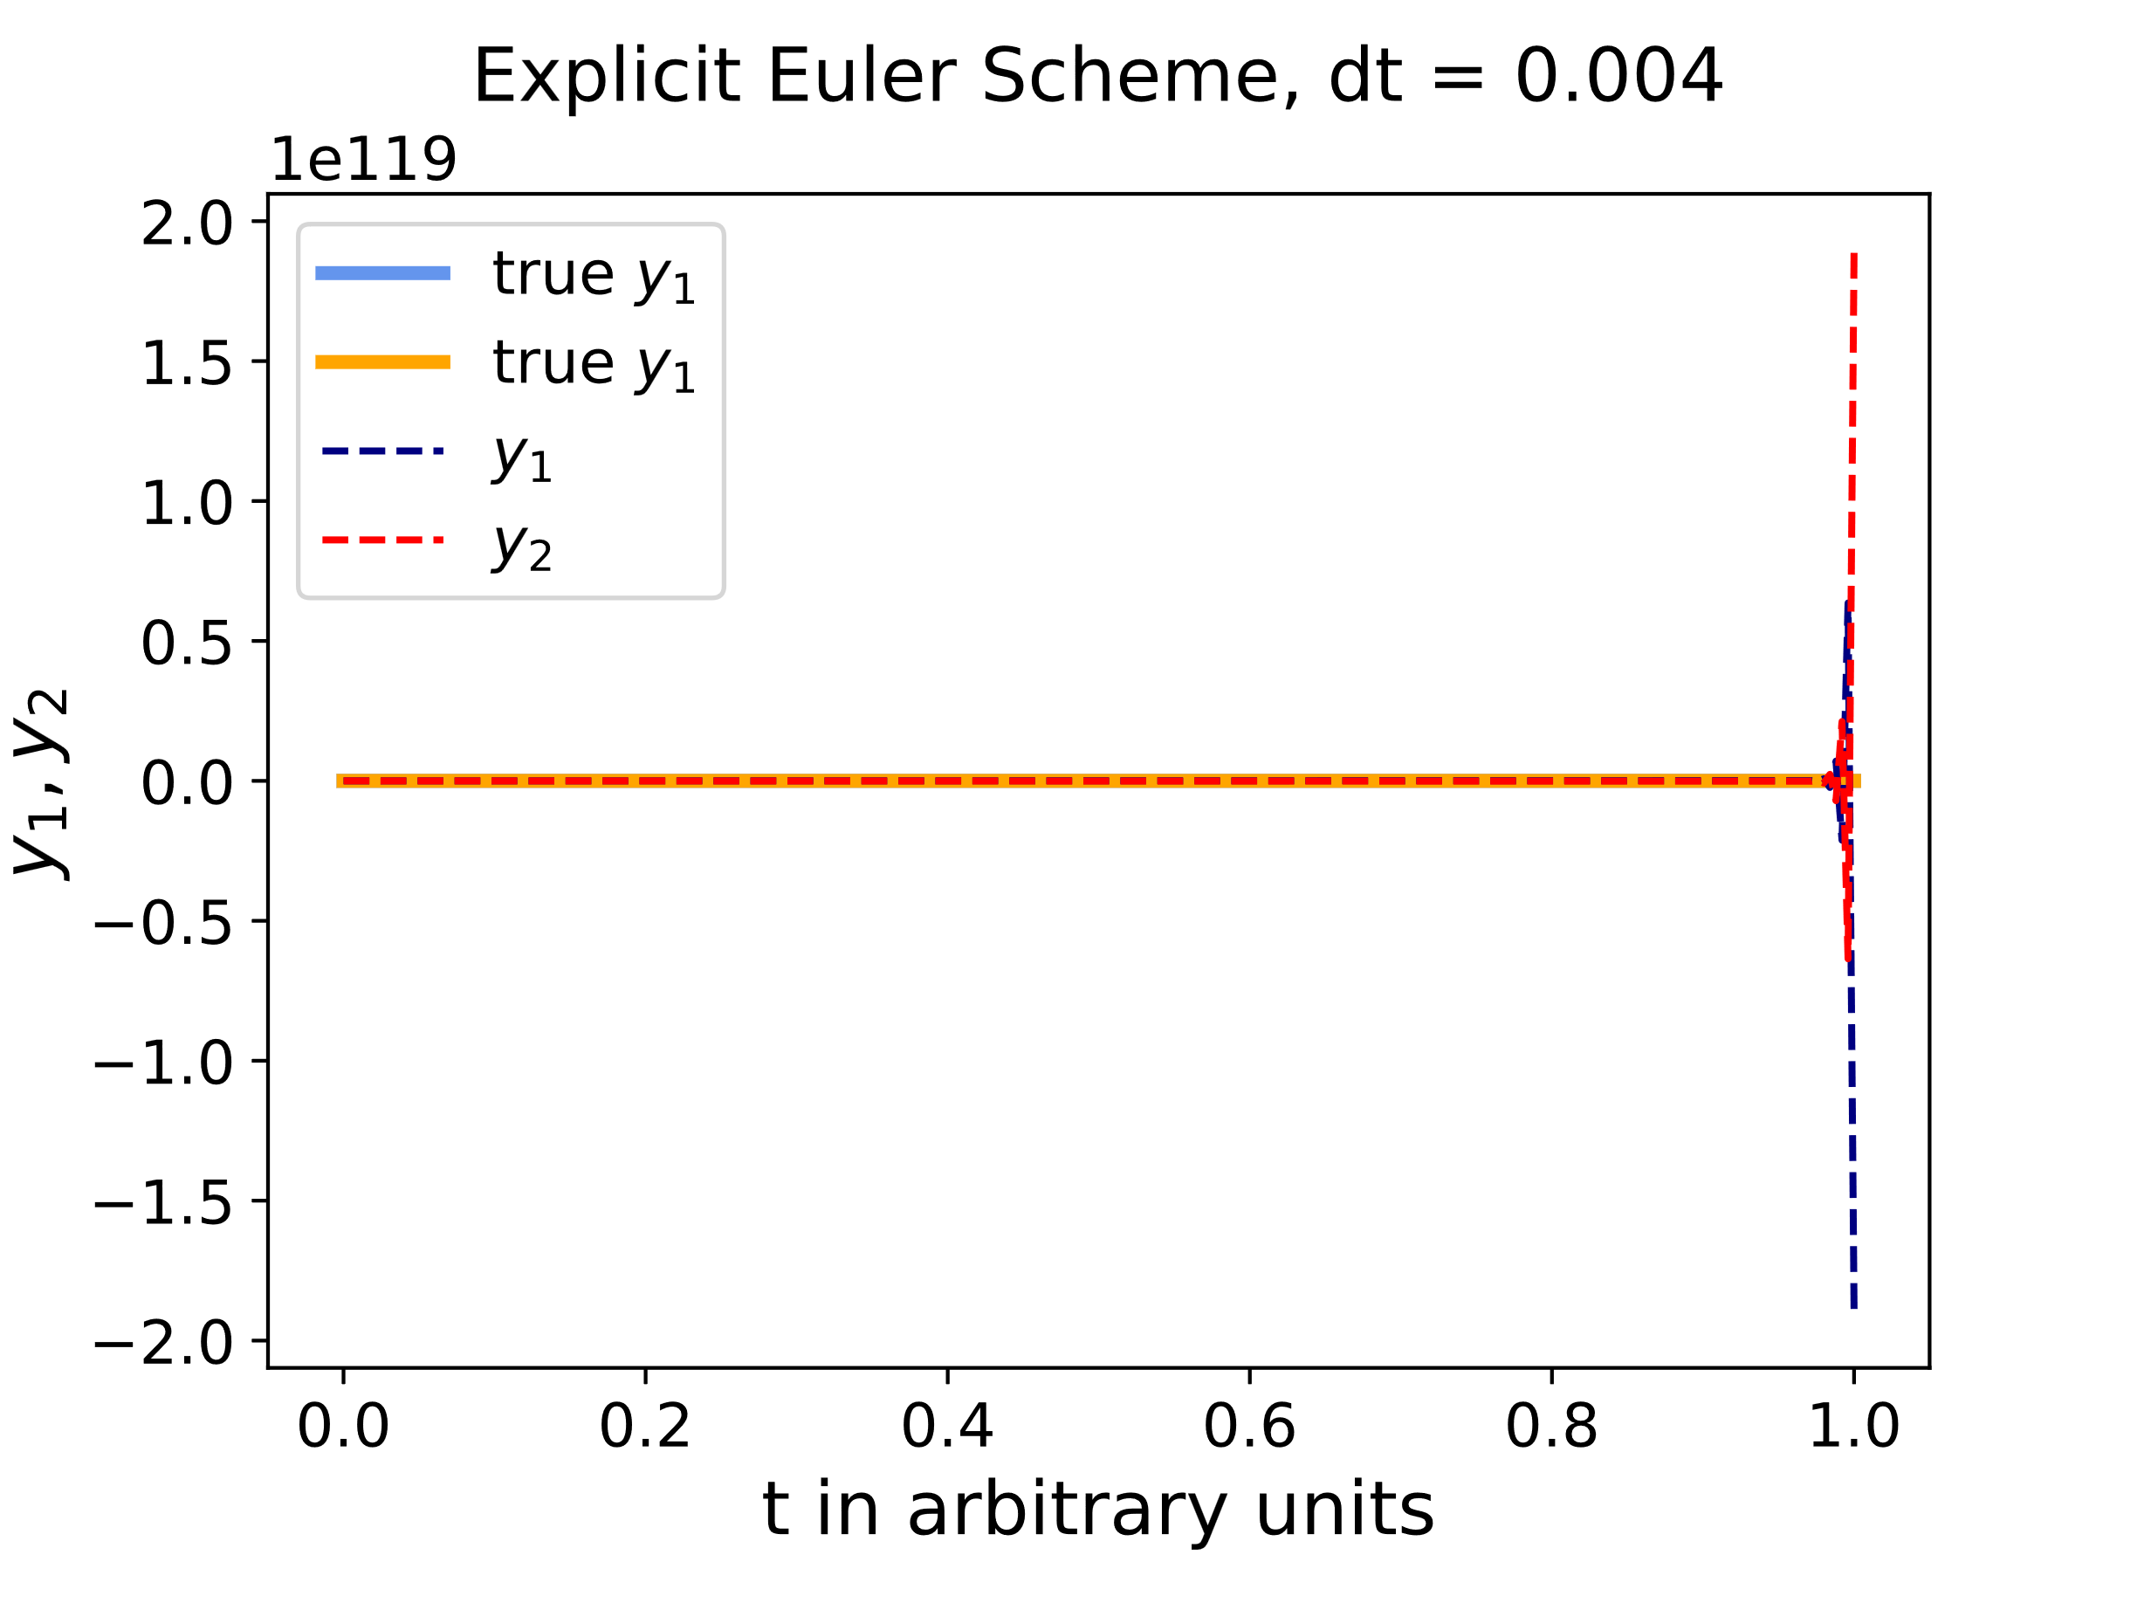
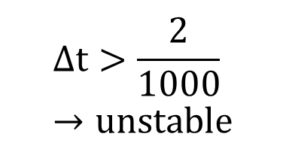
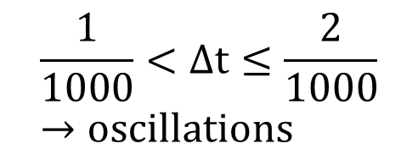
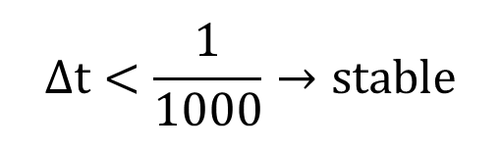
Explicit Schemes in Failure Mode
$$Δt<\frac{1}{1000}→stable$$
$$\frac{1}{1000}<Δt≤\frac{2}{1000}→oscillations$$
$$Δt>\frac{2}{1000}→unstable$$
Timestep excessively small to large scale solution smoothness necessary in explicit method → Stiffness → more efficient approach?
Some Classical Methods | Problem of Conserved Quantities | Problem of Stiffness | Efficiently Solving Stiff ODEs
Notes:
Fastest decaying terms give stability bounds
If we would be interested in the very-short-term behavior we would not notice this stiffness (as we would take very small steps anyways) – but we are interested in longer-timespan evolution.
Not interested in fastest time scale <-> stiff

Slide 21
Efficiently Solving Stiff ODEs

Slide 22
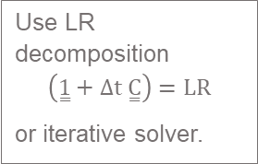
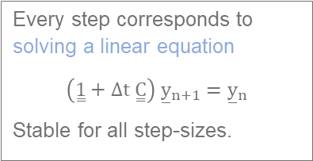
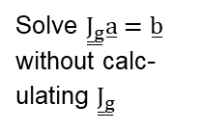
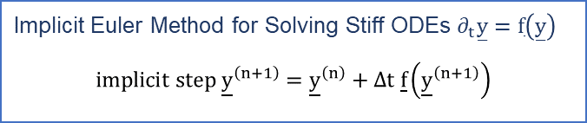
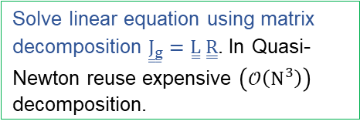
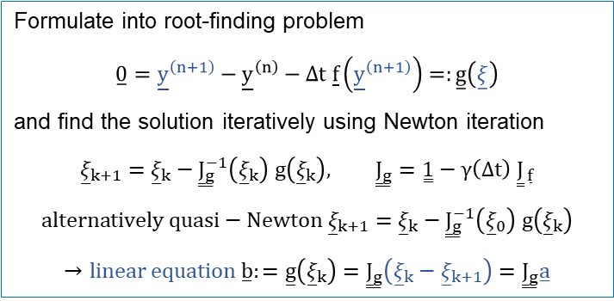
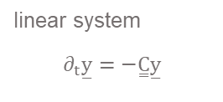
Overview on Solving Stiff ODEs
Implicit Euler Method for Solving Stiff ODEs $∂_{t}\overset{̲}{y}=\overset{̲}{f}\left(\overset{̲}{y}\right)$
$$implicit step {\underline{y}}^{\left(n+1\right)}={\underline{y}}^{\left(n\right)}+Δt \underline{f}\left({\underline{y}}^{\left(n+1\right)}\right)$$
non-linear system
Formulate into root-finding problem
$$\overset{̲}{0}={\underline{y}}^{\left(n+1\right)}−{\underline{y}}^{\left(n\right)}−Δt \underline{f}\left({\underline{y}}^{\left(n+1\right)}\right)=:\overset{̲}{g}\left(\overset{̲}{ξ}\right)$$
and find the solution iteratively using Newton iteration
$${\overset{̲}{ξ}}_{k+1}={\overset{̲}{ξ}}_{k}−{\overset{̳}{J}}_{\overset{̲}{g}}^{−1}\left({\overset{̲}{ξ}}_{k}\right) g\left({\overset{̲}{ξ}}_{k}\right), {\overset{̳}{J}}_{\overset{̲}{g}}=\overset{̳}{1}−γ\left(Δt\right) {\overset{̳}{J}}_{ \overset{̲}{f}}$$
$$alternatively quasi−Newton {\overset{̲}{ξ}}_{k+1}={\overset{̲}{ξ}}_{k}−{\overset{̳}{J}}_{\overset{̲}{g}}^{−1}\left({\overset{̲}{ξ}}_{0}\right) g\left({\overset{̲}{ξ}}_{k}\right)$$
$$→linear equation \overset{̲}{b}:=\overset{̲}{g}\left({\overset{̲}{ξ}}_{k}\right)={\overset{̳}{J}}_{\overset{̲}{g}}^{ }\left({\overset{̲}{ξ}}_{k}−{\overset{̲}{ξ}}_{k+1}\right)={\overset{̳}{J}}_{\overset{̲}{g}}^{ }\overset{̲}{a}$$
linear system
$$∂_{t}\overset{̲}{y}=−\overset{̳}{C}\overset{̲}{y}$$
Every step corresponds to solving a linear equation
$$\left(\overset{̳}{1}+Δt \overset{̳}{C}\right) {\overset{̲}{y}}_{n+1}={\overset{̲}{y}}_{n}$$
Stable for all step-sizes.
sparse Jacobian
Jacobian too large to store
Calculate sparse Jacobian using sparse Differentiation (Autodiff with smart direction based on distance-1 graph coloring insights)
Solve ${\overset{̳}{J}}_{\overset{̲}{g}}^{ }\overset{̲}{a}=\overset{̲}{b}$ without calc-ulating ${\overset{̳}{J}}_{\overset{̲}{g}}^{ }$
Solve linear equation using matrix decomposition ${\overset{̳}{J}}_{\overset{̲}{g}}^{ }=\overset{̳}{L} \overset{̳}{R}$. In Quasi-Newton reuse expensive $\left(𝒪\left(N^{3}\right)\right)$ decomposition.
Calculate only Jacobian-Vector products using Autodiff and solve the Linear equation using Krylov-Subspace methods.
Use LR decomposition $$\left(\overset{̳}{1}+Δt \overset{̳}{C}\right)=LR$$
or iterative solver.
Ground level: Solve linear system
Option A for solving the linear system involving the Jacobian
Option B for solving the linear system involving the Jacobian

Slide 23
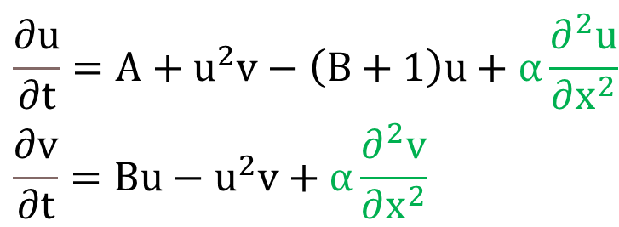
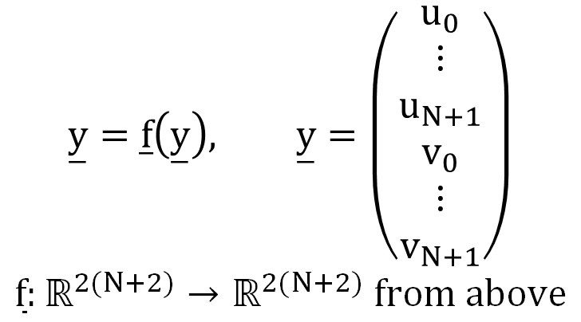
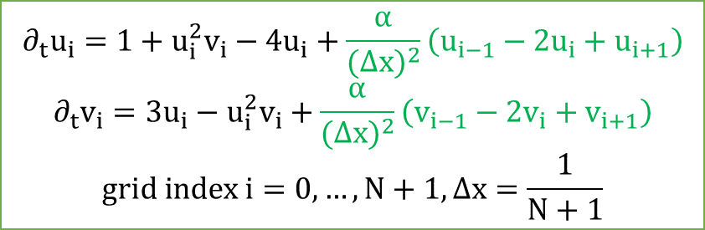
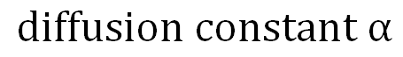
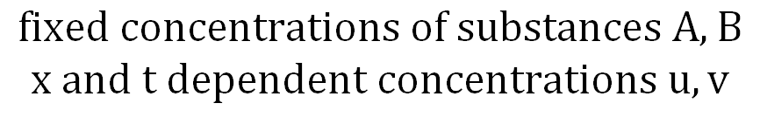
Introduction of the Brusselator | Note on PDEs
Turn into ODE by method of lines
discretize all partial derivatives but 1
Non-linear chemical-reaction-diffusion partial differential equation in 1D
$$∂_{t}u_{i}=1+u_{i}^{2}v_{i}−4u_{i}+\frac{α}{(Δx)^{2}}\left(u_{i−1}−2u_{i}+u_{i+1}\right)$$
$$∂_{t}v_{i}=3u_{i}−u_{i}^{2}v_{i}+\frac{α}{(Δx)^{2}}\left(v_{i−1}−2v_{i}+v_{i+1}\right)$$
$$grid index i=0,…,N+1, Δx=\frac{1}{N+1}$$
$$\begin{aligned}&\frac{∂u}{∂t}=A+u^{2}v−\left(B+1\right)u+α\frac{∂^{2}u}{∂x^{2}} \\ &\frac{∂v}{∂t}=Bu−u^{2}v+α\frac{∂^{2}v}{∂x^{2}}\end{aligned}$$
write compactly as
$$\overset{̲}{y}=\overset{̲}{f}\left(\overset{̲}{y}\right), \overset{̲}{y}=\left(\begin{aligned}u_{0} \\ ⋮ \\ u_{N+1} \\ v_{0} \\ ⋮ \\ v_{N+1}\end{aligned}\right)$$
$$\overset{̲}{f}:ℝ^{2(N+2)}→ℝ^{2(N+2)} from above$$
$$fixed concentrations of substances A,B$$
$$x and t dependent concentrations u,v$$
$$diffusion constant α$$
Some Classical Methods | Problem of Conserved Quantities | Problem of Stiffness | Efficiently Solving Stiff ODEs
Notes:
Stress the information flow!

Slide 24
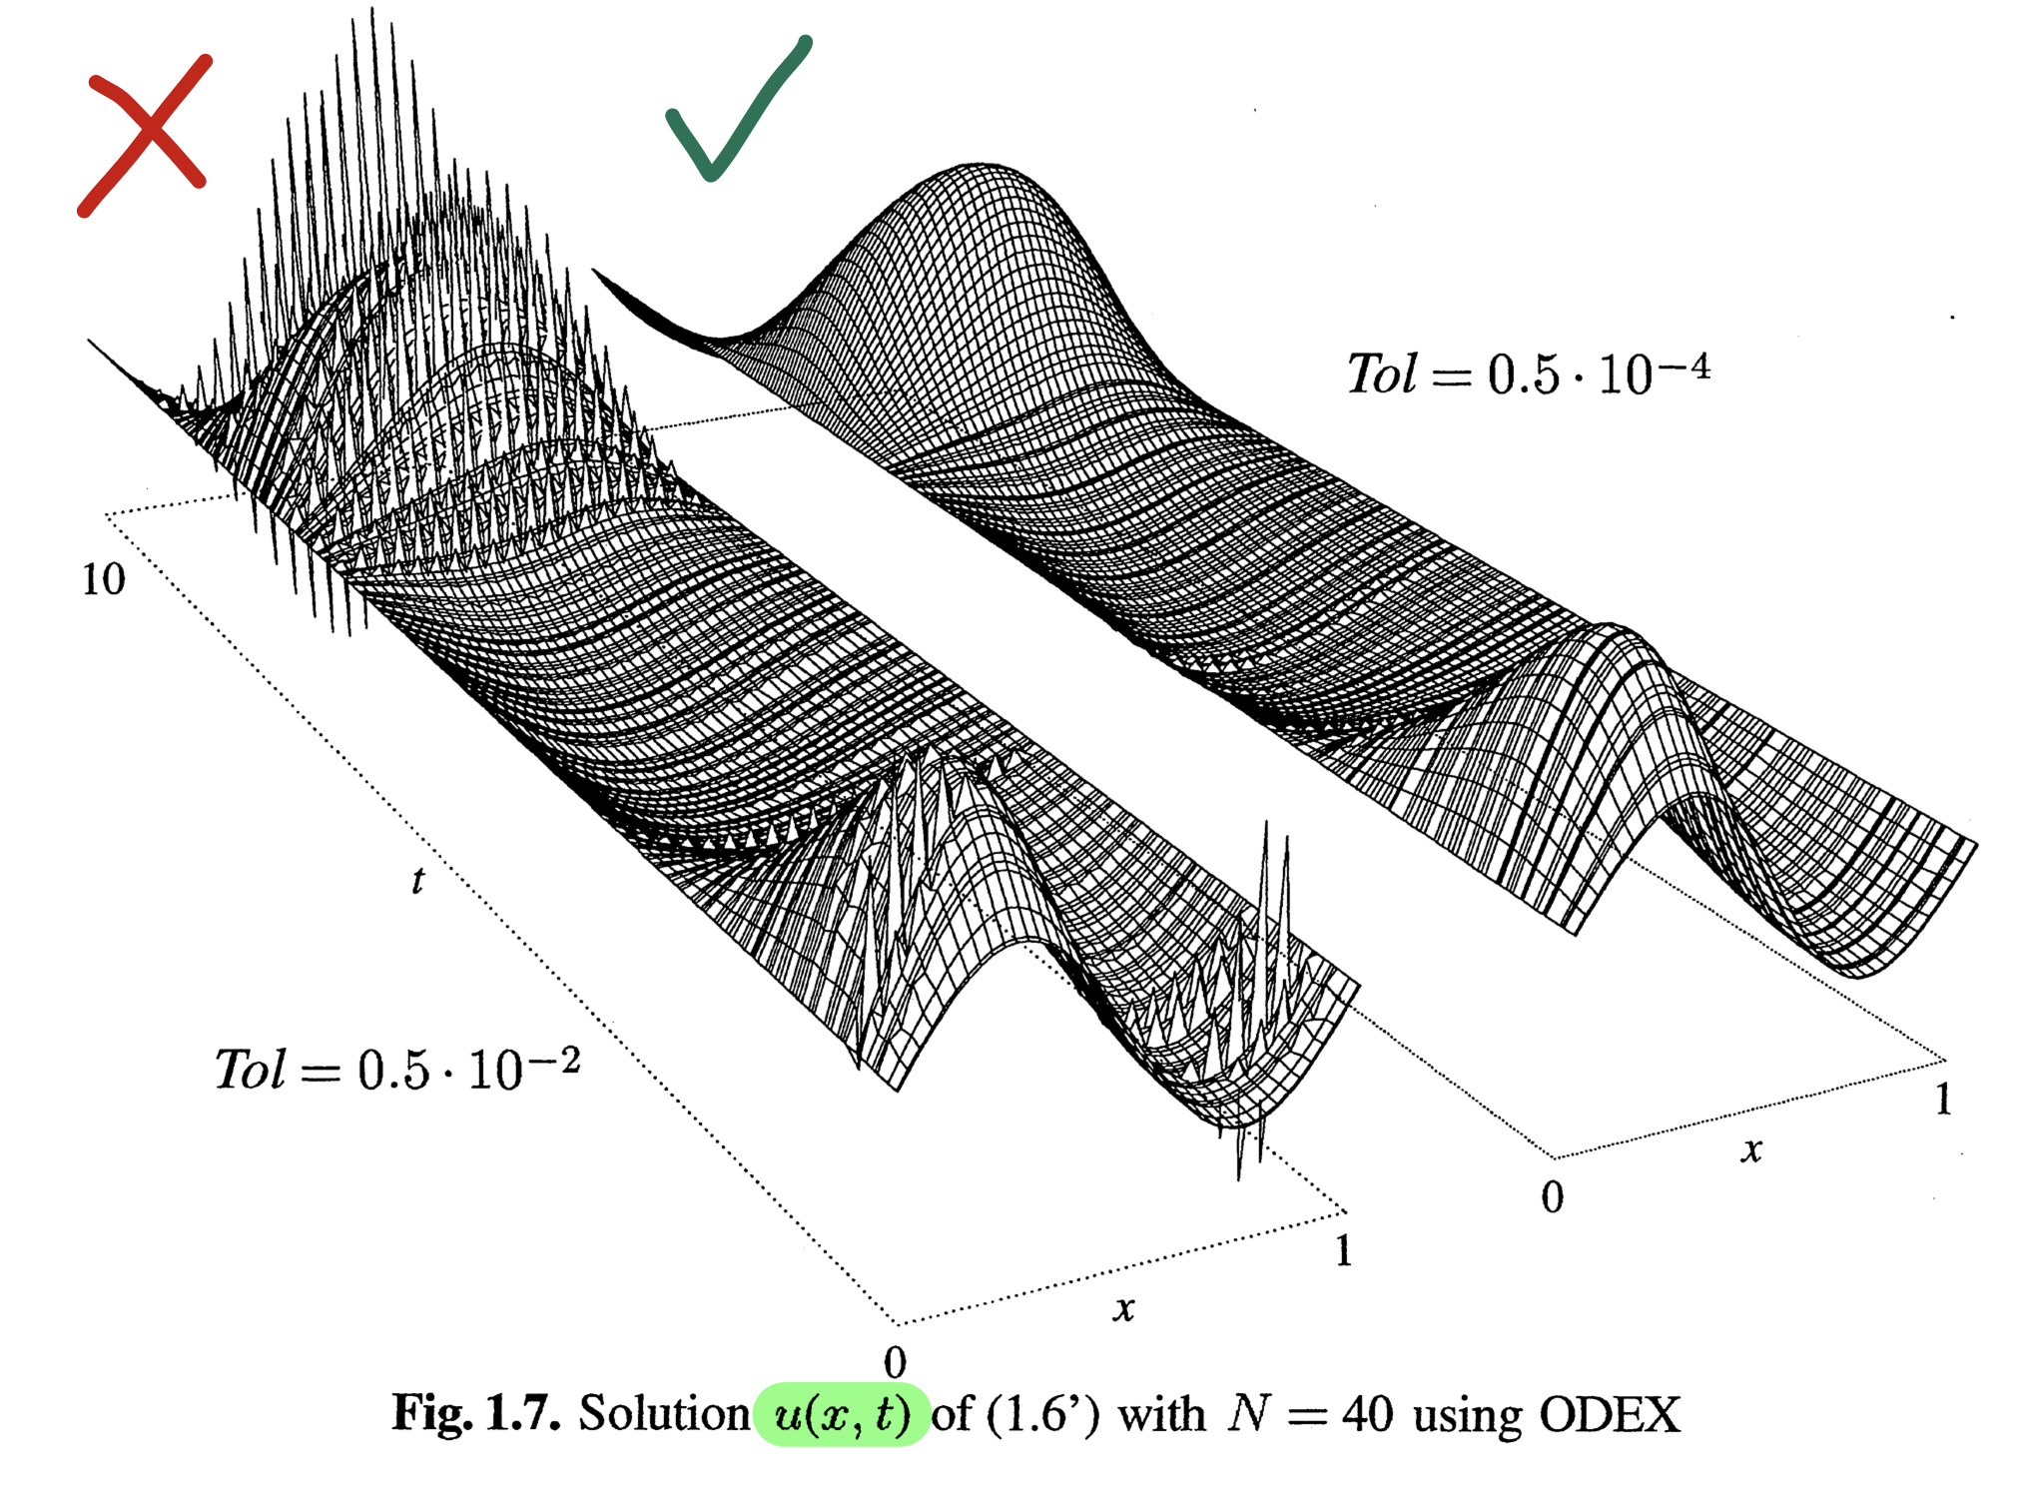
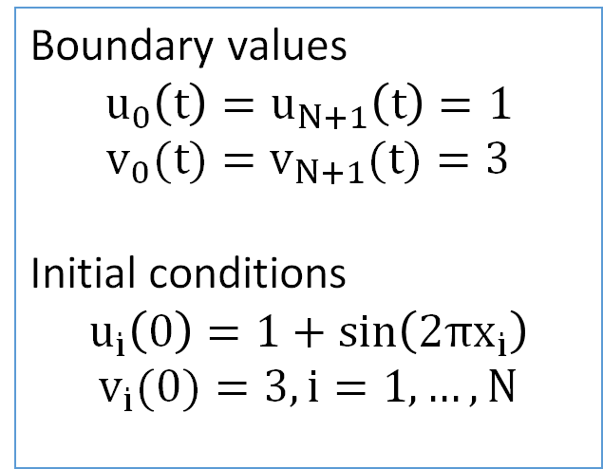
Boundary values and textbook solution
Boundary values
$$u_{0}\left(t\right)=u_{N+1}\left(t\right)=1$$
$$v_{0}(t)=v_{N+1}(t)=3$$
Initial conditions
$$u_{i}\left(0\right)=1+sin\left(2πx_{i}\right)$$
$$v_{i}(0)=3,i=1,…,N$$
Textbook solution from “Solving Stiff ODEs II”
by E. Hairer and G. Wanner
Some Classical Methods | Problem of Conserved Quantities | Problem of Stiffness | Efficiently Solving Stiff ODEs

Slide 25
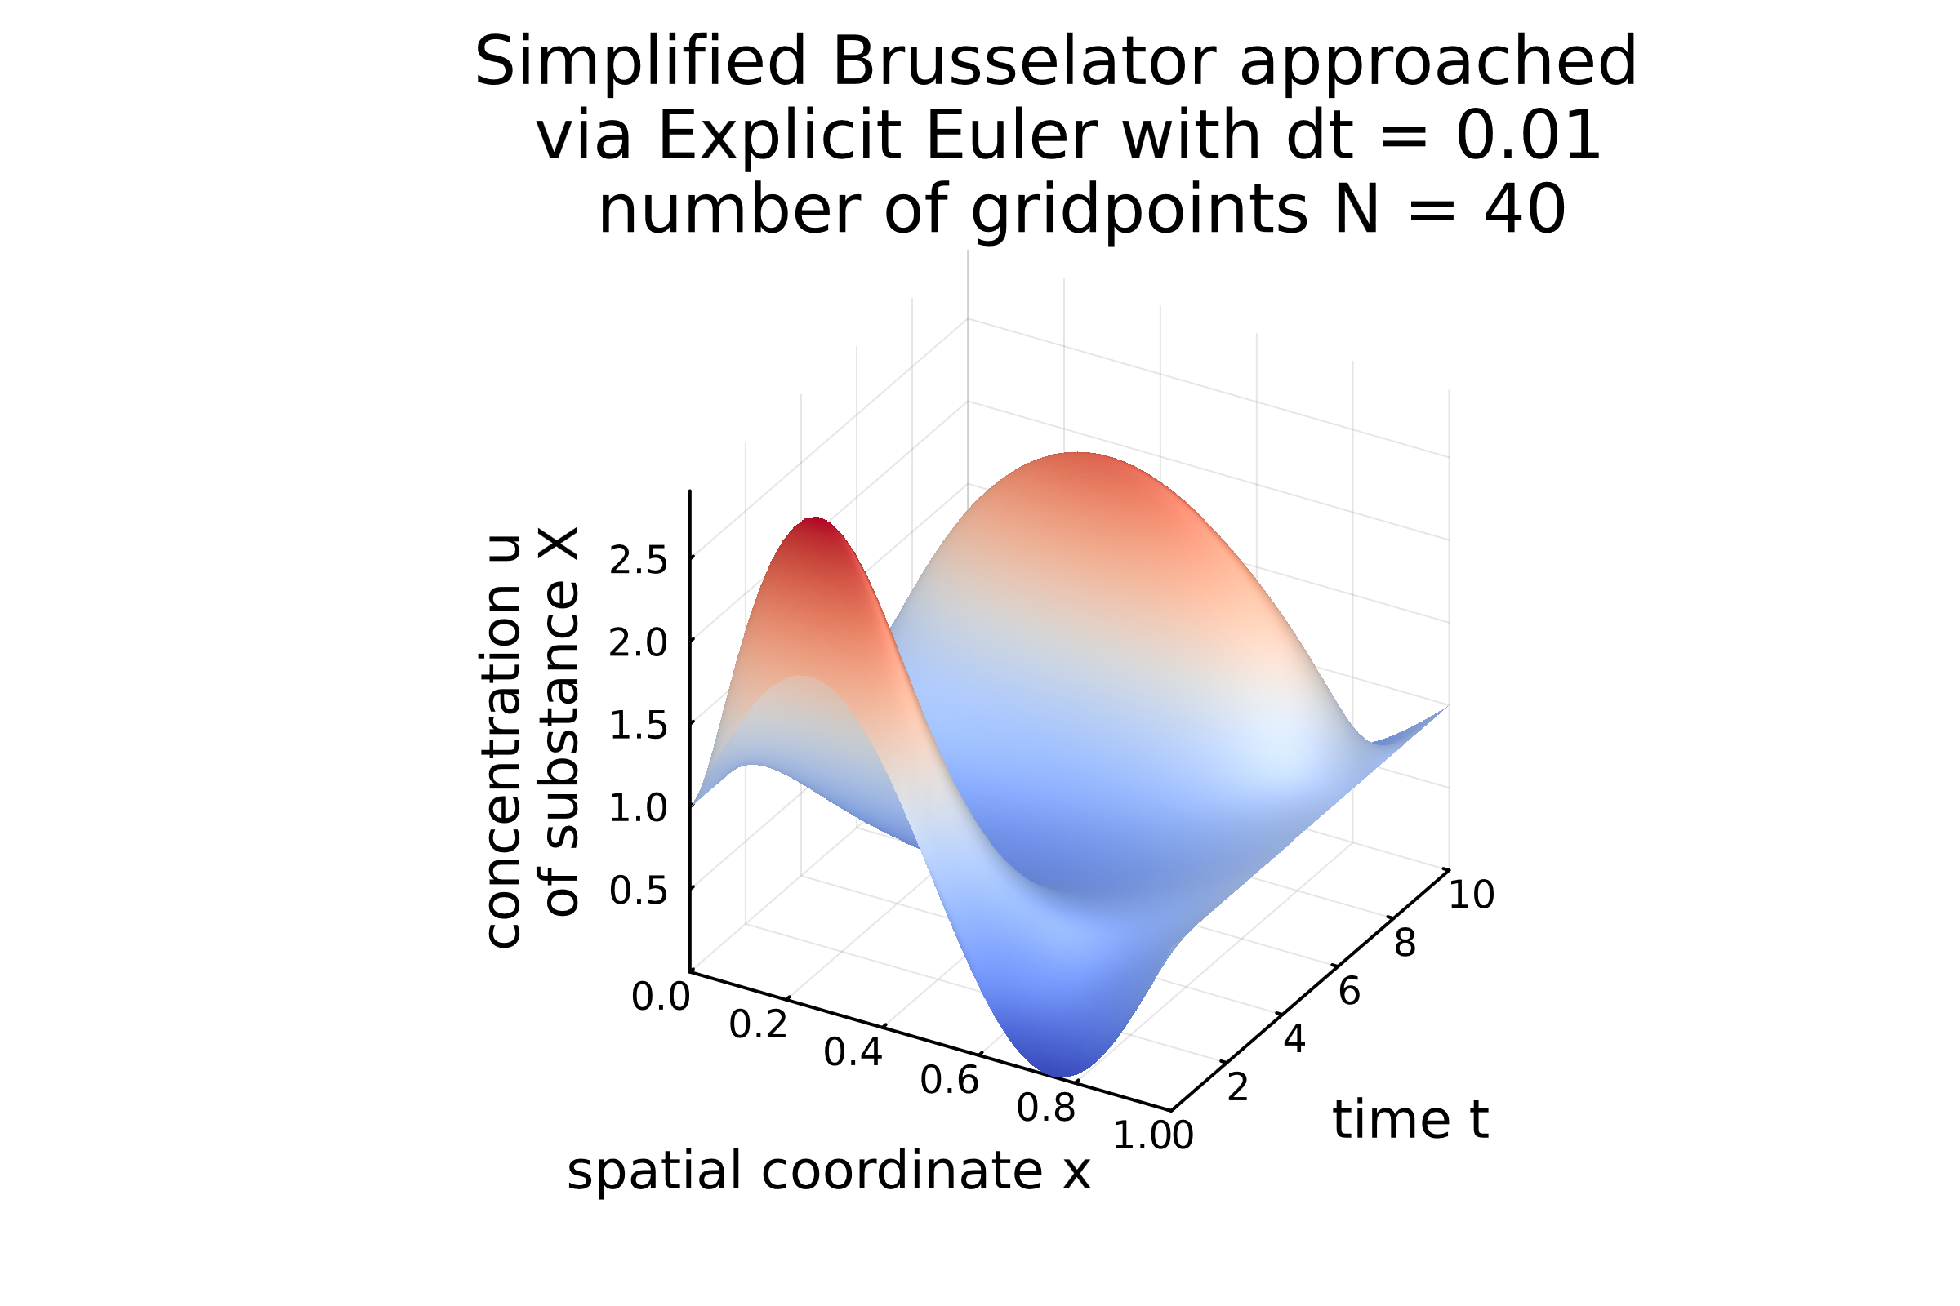
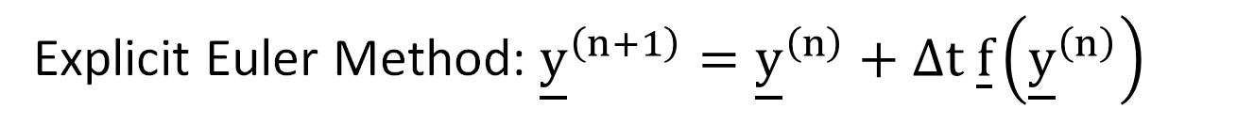
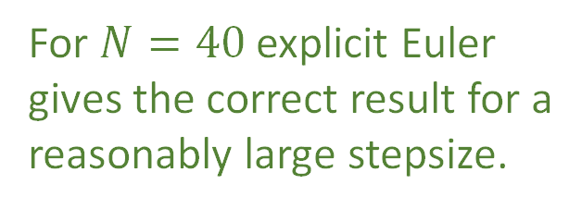
Can we use an explicit method? | On Stiffness
Explicit Euler Method: ${\underline{y}}^{\left(n+1\right)}={\underline{y}}^{\left(n\right)}+Δt \underline{f}\left({\underline{y}}^{\left(n\right)}\right)$
For $N=40$ explicit Euler gives the correct result for a
reasonably large stepsize.
Some Classical Methods | Problem of Conserved Quantities | Problem of Stiffness | Efficiently Solving Stiff ODEs

Slide 26

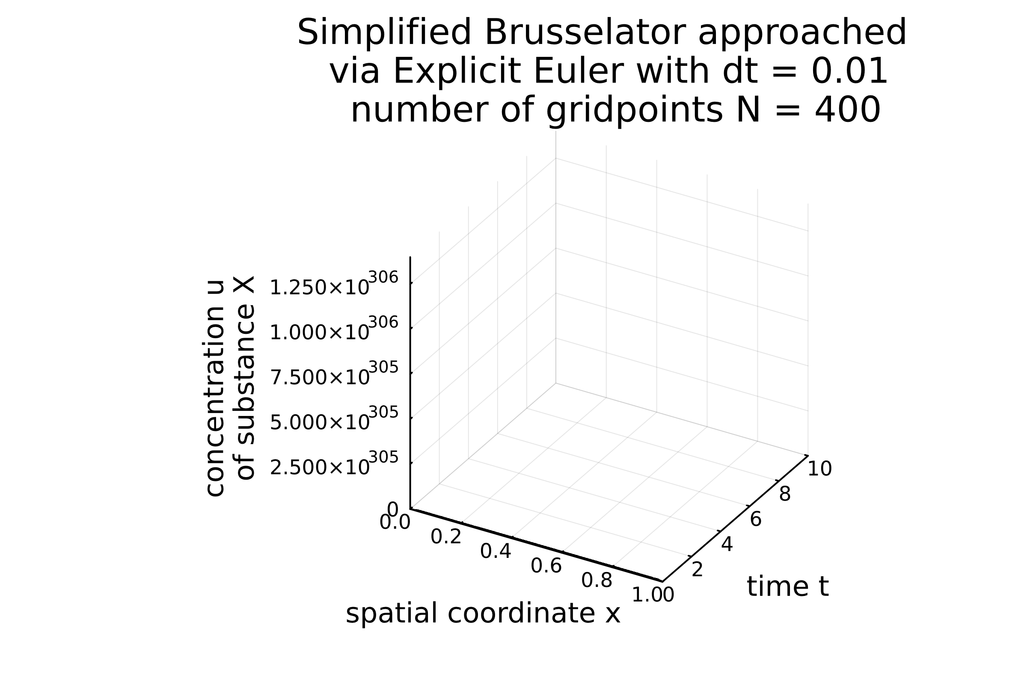
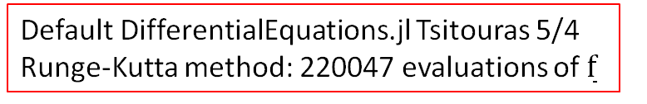
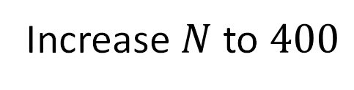
The Occurrence of Stiffness
Decrease step-size
Increase $N$ to $400$
diverges,
unstable
Default DifferentialEquations.jl Tsitouras 5/4 Runge-Kutta method: 220047 evaluations of $\overset{̲}{f}$
Some Classical Methods | Problem of Conserved Quantities | Problem of Stiffness | Efficiently Solving Stiff ODEs

Slide 27
A Practical Definition of Stiffness
e. g. explicit Euler Method
»If a numerical method with a finite region of absolute stability, applied to a system with any initial conditions, is forced to use in a certain interval of integration a step length which is excessively small in relation to the smoothness of the exact solution in that interval, then the system is said to be stiff in that interval.«
J. D. Lambert, “Numerical Methods for ordinary Differential Systems”, chapter 6
Some Classical Methods | Problem of Conserved Quantities | Problem of Stiffness | Efficiently Solving Stiff ODEs
Notes:
Same as linear stability domain

Slide 28
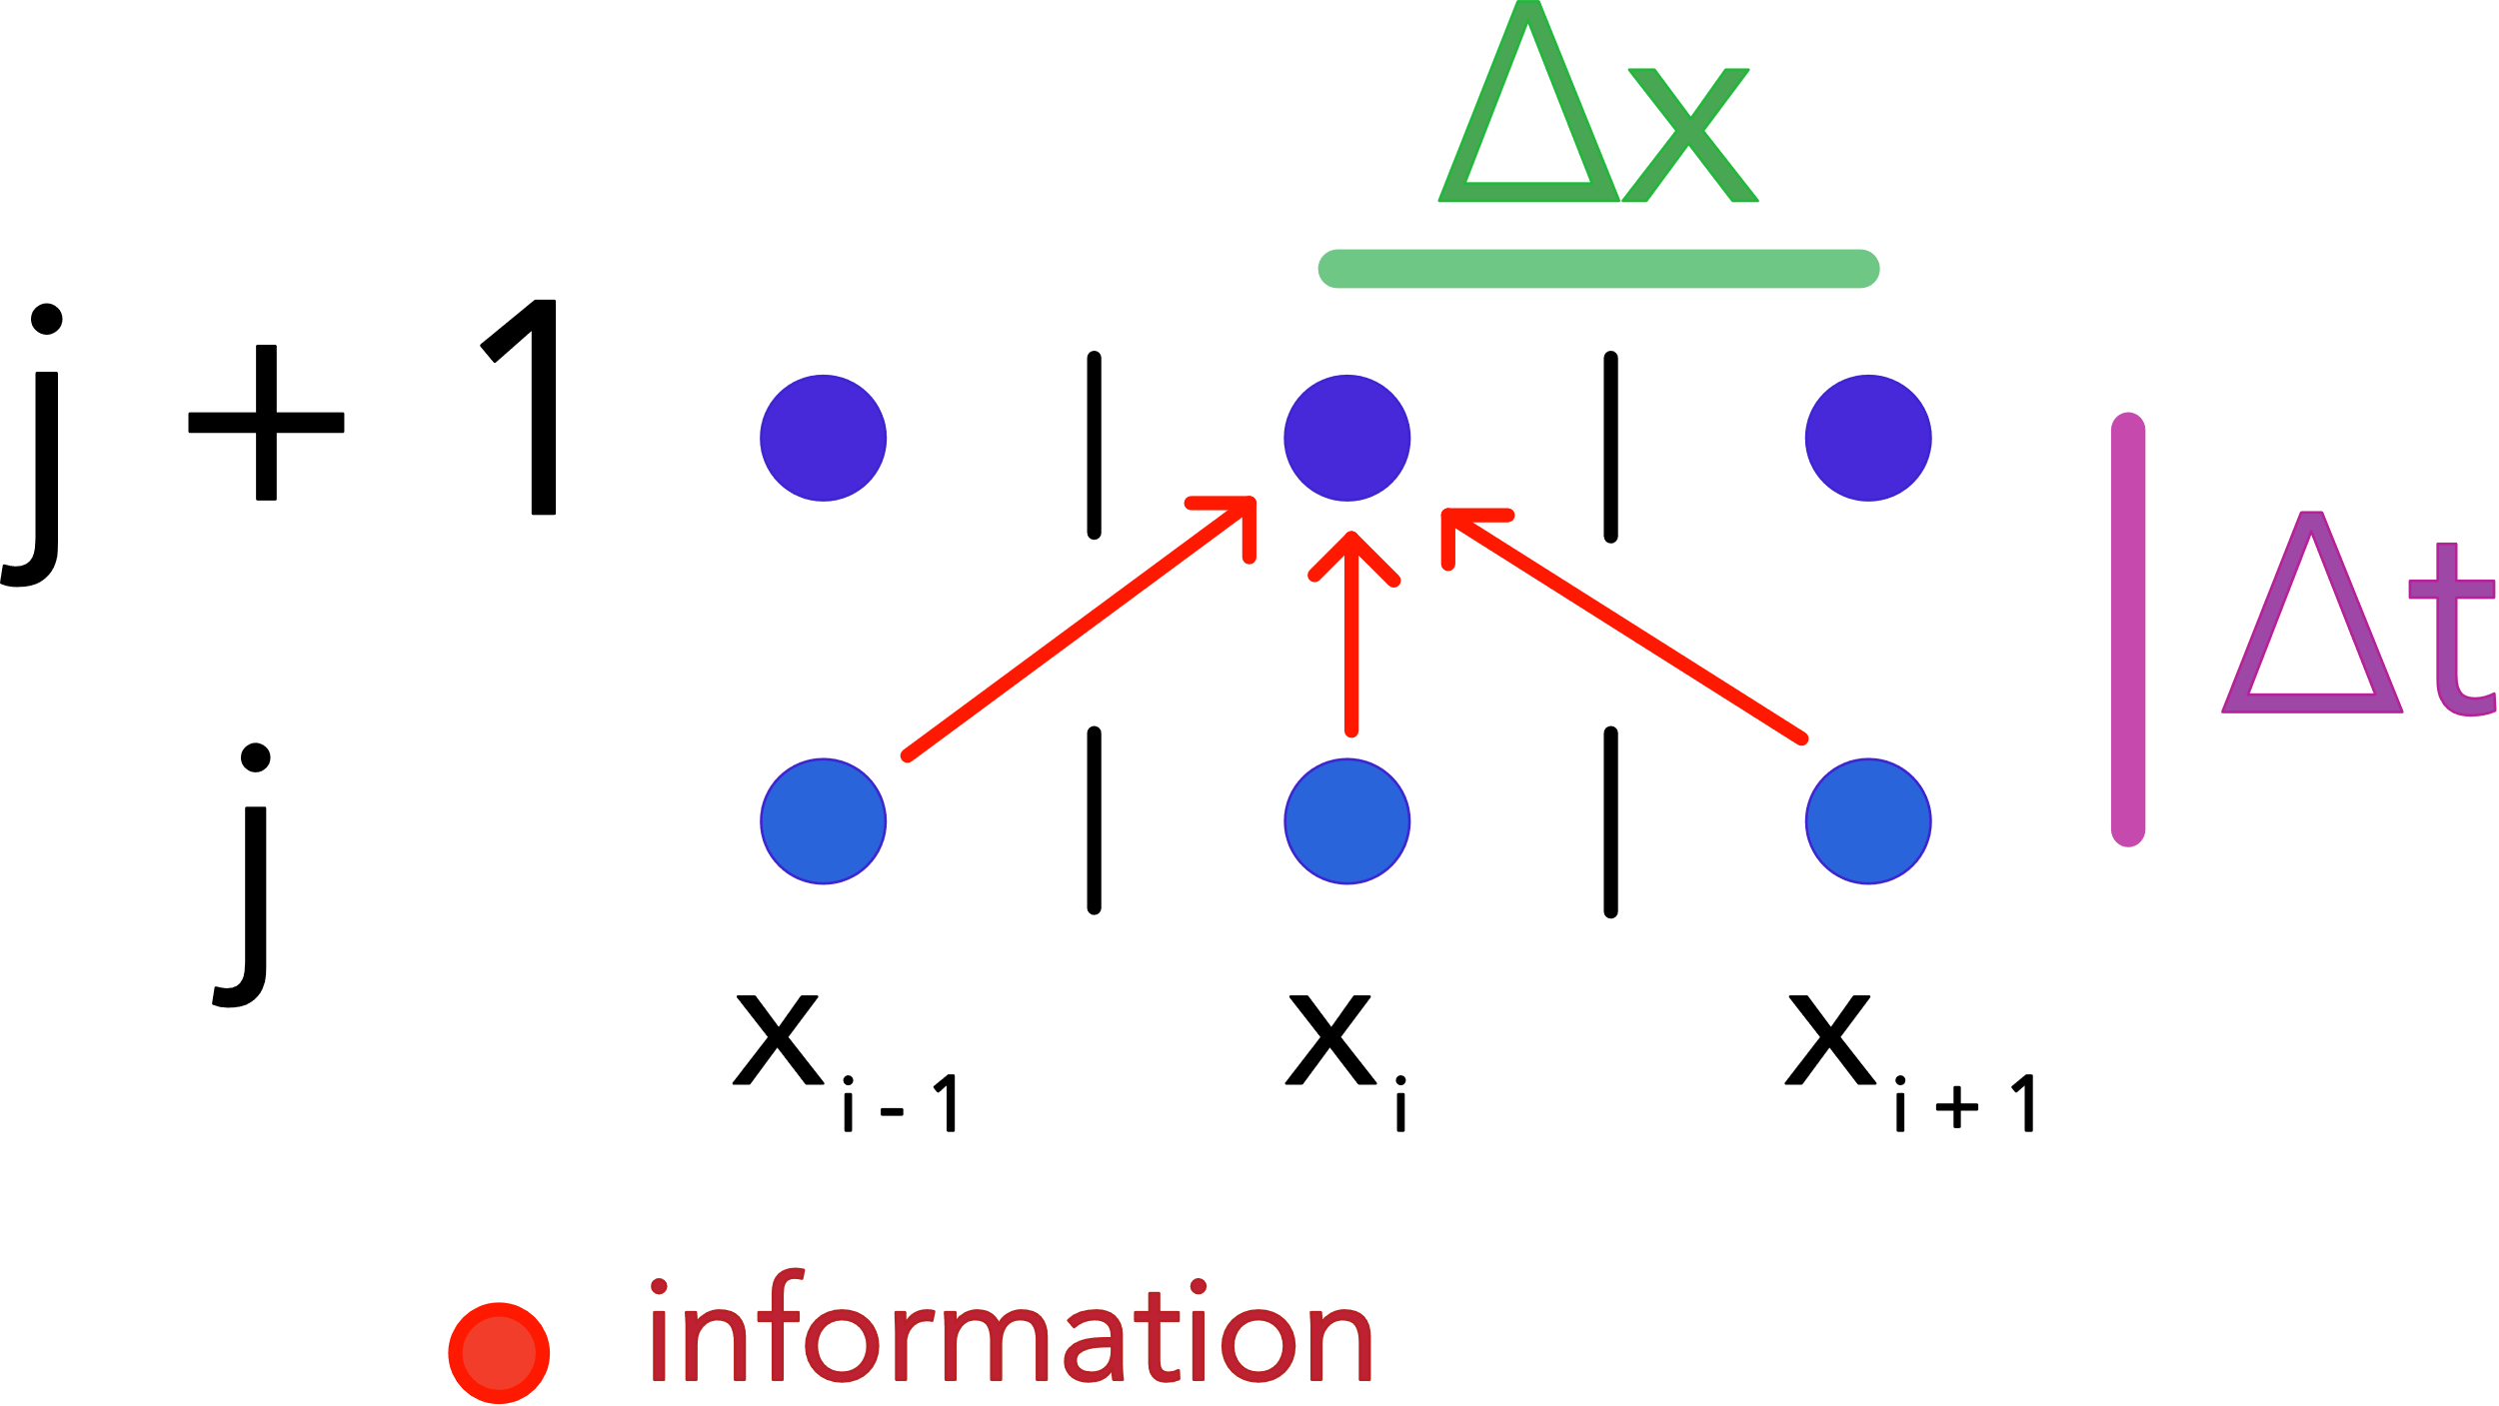
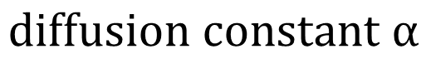
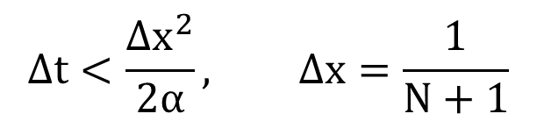
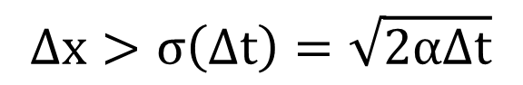


Understanding Stiffness in a Diffusive Context
In every explicit step, only neighboring cells communicate.
Concentration spreads with $σ=\sqrt{2αt}$
$$Δx>σ\left(Δt\right)=\sqrt{2αΔt}$$
$$diffusion constant α$$
$$Δt<\frac{Δx^{2}}{2α}, Δx=\frac{1}{N+1}$$
$$number N of gridpoints in [0,1]$$
Problem: Double resolution $\frac{Δx}{2}$ → need $𝒪\left(N^{2}\right)$ more steps to cover the timespan, every step $𝒪\left(N\right)$ more complex → $𝒪\left(N^{3}\right)$
Some Classical Methods | Problem of Conserved Quantities | Problem of Stiffness | Efficiently Solving Stiff ODEs

Slide 29





The Implicit Approach | Implicit Euler Method
Implicit Euler Method for Solving Stiff ODEs $∂_{t}\overset{̲}{y}=\overset{̲}{f}\left(\overset{̲}{y}\right)$
$$implicit step {\underline{y}}^{\left(n+1\right)}={\underline{y}}^{\left(n\right)}+Δt \underline{f}\left({\underline{y}}^{\left(n+1\right)}\right)$$
Formulate taking one timestep as root-finding problem
$$\overset{̲}{0}={\underline{y}}^{\left(n+1\right)}−{\underline{y}}^{\left(n\right)}−Δt \underline{f}\left({\underline{y}}^{\left(n+1\right)}\right)=:\overset{̲}{g}\left(\overset{̲}{ξ}\right)$$
Solve one timestep iteratively using Newton iteration
$${\overset{̲}{ξ}}_{k+1}={\overset{̲}{ξ}}_{k}−{\overset{̳}{J}}_{\overset{̲}{g}}^{−1}\left({\overset{̲}{ξ}}_{k}\right) g\left({\overset{̲}{ξ}}_{k}\right), {\overset{̳}{J}}_{\overset{̲}{g}}=\overset{̳}{1}−γ\left(Δt\right) {\overset{̳}{J}}_{ \overset{̲}{f}}$$
$${\overset{̲}{ξ}}_{0}={\underline{y}}^{\left(n\right)}, {\overset{̲}{ξ}}_{m}\overset{→}{m→∞}{\underline{y}}^{\left(n+1\right)}$$
$$alternatively quasi−Newton {\overset{̲}{ξ}}_{k+1}={\overset{̲}{ξ}}_{k}−{\overset{̳}{J}}_{\overset{̲}{g}}^{−1}\left({\overset{̲}{ξ}}_{0}\right) g\left({\overset{̲}{ξ}}_{k}\right)$$
In each step of the Newton-iteration calculate ${\overset{̲}{ξ}}_{k+1}$ from
$$linear equation \overset{̲}{b}:=\overset{̲}{g}\left({\overset{̲}{ξ}}_{k}\right)={\overset{̳}{J}}_{\overset{̲}{g}}^{ }\left({\overset{̲}{ξ}}_{k}−{\overset{̲}{ξ}}_{k+1}\right)={\overset{̳}{J}}_{\overset{̲}{g}}^{ }\overset{̲}{a}$$
Some Classical Methods | Problem of Conserved Quantities | Problem of Stiffness | Efficiently Solving Stiff ODEs
Notes:
To implicit Euler: Search y_n+1 so that shooting back along the local gradient yields current value
Linear equation is intuitive: Bring to zero than its obvious that we seek direction so that directional derivative – starting from the current point - gets us to zero
Q: Whats the difference between Newton and Quasi-Newton

Slide 30


Goal: Make implicit step using (Quasi-) Newton
$${\underline{y}}^{\left(n+1\right)}−Δt \underline{f}\left({\underline{y}}^{\left(n+1\right)}\right)={\underline{y}}^{\left(n\right)}$$
Some Classical Methods | Problem of Conserved Quantities | Problem of Stiffness | Efficiently Solving Stiff ODEs

Slide 31



How to solve the linear system $\overset{̲}{g}\left({\overset{̲}{ξ}}_{k}\right)={\overset{̳}{J}}_{\overset{̲}{g}}^{ }\overset{̲}{a}$?
Remember: Calculate a Jacobian Vector product (directional derivative)
$${\overset{̳}{J}}_{\overset{̲}{g}} \overset{̲}{v}=\left(\overset{̲}{∇}⋅\overset{̲}{g}\right) \overset{̲}{v}, {\overset{̳}{J}}_{\overset{̲}{g}}{\overset{̲}{\hat{e}}}_{j} calculates j−th column of Jacobian$$
to machine precision using one forward mode AD calculation
$$\overset{̲}{g}\left(\overset{̲}{ξ}+ϵ\overset{̲}{v}\right)=\overset{̲}{g}\left(\overset{̲}{ξ}\right)+ϵ {\overset{̳}{J}}_{\overset{̲}{g}}\overset{̲}{v}, dual number \overset{̲}{ξ}+ϵ\overset{̲}{v}, ϵ^{2}=0$$
Calculate ${\overset{̳}{J}}_{\overset{̲}{g}}$ efficiently and solve
the linear system based on matrix
decomposition.
Solve the system only based on Jacobian-vector-products.
Option A for solving the linear system involving the Jacobian
Option B for solving the linear system involving the Jacobian
Some Classical Methods | Problem of Conserved Quantities | Problem of Stiffness | Efficiently Solving Stiff ODEs

Slide 32




Option A: Jacobi Calculation and Matrix Decomposition for $\overset{̲}{g}\left({\overset{̲}{ξ}}_{k}\right)={\overset{̳}{J}}_{\overset{̲}{g}}^{ }\overset{̲}{a}$
1. Calculate all columns ${\overset{̳}{J}}_{\overset{̲}{g}}{\overset{̲}{\hat{e}}}_{j}$ of the Jacobian
$$\overset{̲}{g}\left(\overset{̲}{ξ}+ϵ{\overset{̲}{\hat{e}}}_{j}\right)=\overset{̲}{g}\left(\overset{̲}{ξ}\right)+ϵ {\overset{̳}{J}}_{\overset{̲}{g}}{\overset{̲}{\hat{e}}}_{j}$$
$$j=1,…,2(N+2)$$
$$→𝒪\left(N\right) evaluations of \overset{̲}{f}$$
$$→𝒪\left(N^{2}\right) complexity$$
in Newton iteration in every iterative step
$$\overset{̲}{ξ}={\overset{̲}{ξ}}_{k}$$
in Quasi-Newton once per timestep
$$\overset{̲}{ξ}={\overset{̲}{y}}_{n}$$
2. Do matrix decomposition, e. g.
$$\overset{̳}{P} {\overset{̳}{J}}_{\overset{̲}{g}}^{ }=\overset{̳}{L}\overset{̳}{R} \left(in 𝒪\left(N^{3}\right)\right)$$
$${\overset{̳}{J}}_{\overset{̲}{g}}^{ }\overset{̲}{a}=\overset{̲}{g}⟺\overset{̳}{L} \overset{̳}{R} \overset{̲}{a}=\overset{̲}{g}$$
Q: Why can’t we simply invert ${\overset{̳}{J}}_{\overset{̲}{g}}^{ }$?
3. Solve for $\overset{̲}{a}$
$$1.solve \overset{̳}{L} \overset{̲}{y}=\overset{̲}{g} for \overset{̲}{y}$$
$$(forward substituttion)$$
$$2.solve \overset{̳}{R} \overset{̲}{a}=\overset{̲}{y} for \overset{̲}{y} by forward$$
$$(backward substitution)$$
$$Lower−left matrix \overset{̳}{L}, Upper−right matrix \overset{̳}{R}, permutation matrix \overset{̳}{P}$$
Some Classical Methods | Problem of Conserved Quantities | Problem of Stiffness | Efficiently Solving Stiff ODEs

Slide 33
Comparison between Newton and Quasi-Newton
function newtons_method(f!, xi0, dt, tol, max_iter)
"""
The root of g_zero (and therefore the next step
in time in the implicit Euler scheme) is found
using Newton's method, which is implemented here.
"""
xi = copy(xi0)
for i in 1:max_iter
#################################################
# Here the LU decomposition is performed O(N^3)
# the full Jacobian is constructed in every step
luJ = lu(Jg(f!, xi, dt)) # Jg constructs
# the Jacobian
#################################################
a = luJ \ g_zero(f!, xi, xi0, dt) # O(N^2)
xi .= xi .- a
if norm(g_zero(f!, xi, xi0, dt)) < tol
return xi
end
end
return xi
end
function quasi_newtons_method(f!, xi0, dt, tol, max_iter)
"""
The root of g_zero (and therefore the next
step in time in the implicit Euler scheme)
is found using Newton's method,
which is implemented here.
"""
xi = copy(xi0)
#################################################
# Here a matrix LU decomposition is performed once
# per implicit Euler timestep, O(N^3)
luJ = lu(Jg(f!, xi, dt))
#################################################
for i in 1:max_iter
a = luJ \ g_zero(f!, xi, xi0, dt) ) # O(N^2)
xi .= xi .- a
if norm(g_zero(f!, xi, xi0, dt)) < tol
return xi
end
end
return xi
end
Some Classical Methods | Problem of Conserved Quantities | Problem of Stiffness | Efficiently Solving Stiff ODEs

Slide 34




Looks good and that at $Δt=0.1$
Efficiency of our simple implementations
Explicit Euler, $dt=0.0001$ | Implicit Euler; Newton, $dt=0.1$ | Implicit Euler; Quasi-Newton, $dt=0.1$
1.848 s (1447185 allocations: 5.95 GiB) | 6.737 s (396055 allocations: 11.48 GiB) | 3.144 s (197980 allocations: 5.57 GiB)
Problem I: Calculation of the Jacobian column-by-column is very expensive.
Problem II: The matrix factorization with $𝒪\left(N^{3}\right)$ is also expensive but a highly optimized problem (→ LAPACK)
Some Classical Methods | Problem of Conserved Quantities | Problem of Stiffness | Efficiently Solving Stiff ODEs

Slide 35





Sparsity of the Jacobian
Examples for $N=5$ for explainability.
$$\frac{∂g_{2}}{∂ξ_{7}}=0$$
$$N=400:\frac{\# non−zero elements}{\# all elements}≈6⋅{10}^{−5}$$
Q: How can we use this sparsity?
Some Classical Methods | Problem of Conserved Quantities | Problem of Stiffness | Efficiently Solving Stiff ODEs

Slide 36


Intermezzo: Non-Overlapping differentiations
Consider e. g.
$$\overset{̲}{f}\left(\overset{̲}{x}\right)=\left(\begin{aligned}x_{1}+x_{3} \\ x_{2}x_{3} \\ x_{1}\end{aligned}\right), {\overset{̳}{J}}_{\overset{̲}{f}}=\left(\begin{matrix}\frac{∂f_{1}}{∂x_{1}} & \frac{∂f_{1}}{∂x_{2}} & \frac{∂f_{1}}{∂x_{3}} \\ \frac{∂f_{2}}{∂x_{1}} & \frac{∂f_{2}}{∂x_{2}} & \frac{∂f_{2}}{∂x_{3}} \\ \frac{∂f_{3}}{∂x_{1}} & \frac{∂f_{3}}{∂x_{2}} & \frac{∂f_{3}}{∂x_{3}}\end{matrix}\right), sparsity {\overset{̳}{𝒮}}_{ \overset{̲}{f}}=\left(\begin{matrix}1 & 0 & 1 \\ 0 & 1 & 1 \\ 1 & 0 & 0\end{matrix}\right)$$
where
$$\frac{\overset{̲}{f}\left(\overset{̲}{x}+h{\hat{\overset{̲}{e}}}_{1}\right)−\overset{̲}{f}\left(\overset{̲}{x}\right)}{h}=\left(\begin{aligned}1 \\ 0 \\ 1\end{aligned}\right), \frac{\overset{̲}{f}\left(\overset{̲}{x}+h{\hat{\overset{̲}{e}}}_{2}\right)−\overset{̲}{f}\left(\overset{̲}{x}\right)}{h}=\left(\begin{aligned}0 \\ x_{3} \\ 0\end{aligned}\right)$$
and
$$\frac{\overset{̲}{f}\left(\overset{̲}{x}+h{\hat{\overset{̲}{e}}}_{1}+h{\hat{\overset{̲}{e}}}_{2}\right)−\overset{̲}{f}\left(\overset{̲}{x}\right)}{h}=\left(\begin{aligned}1 \\ x_{3} \\ 1\end{aligned}\right)=\left(\begin{aligned}1 \\ 0 \\ 1\end{aligned}\right)+\left(\begin{aligned}0 \\ x_{3} \\ 0\end{aligned}\right)\overset{→}{using {\overset{̳}{𝒮}}_{ \overset{̲}{f}}}{\overset{̳}{J}}_{\overset{̲}{f}}=\left(\begin{matrix}1 & 0 & ⋮ \\ 0 & x_{3} & ⋮ \\ 1 & 0 & ⋮\end{matrix}\right)$$
Twiggling at $x_{1}$ and $x_{2}$ has no cross effects thus separates additively
Changing $x_{2}$ neither effects $f_{1}$ nor $f_{3}$
Some Classical Methods | Problem of Conserved Quantities | Problem of Stiffness | Efficiently Solving Stiff ODEs

Slide 37



Idea: Calculate columns of the Jacobian in non-overlapping groups
Calculate e. g. the blue group in one forward pass
$${\overset{̳}{J}}_{\overset{̲}{g}}\left({\overset{̲}{\hat{e}}}_{3}+{\overset{̲}{\hat{e}}}_{7}+{\overset{̲}{\hat{e}}}_{8}+{\overset{̲}{\hat{e}}}_{12}\right)=:\overset{̲}{JVP}$$
$=\left(\begin{aligned}0 \\ {\left(JVP\right)}_{2} \\ {\left(JVP\right)}_{3} \\ {\left(JVP\right)}_{4} \\ {\left(JVP\right)}_{5} \\ {\left(JVP\right)}_{6} \\ 0 \\ 0 \\ {\left(JVP\right)}_{9} \\ {\left(JVP\right)}_{10} \\ {\left(JVP\right)}_{11} \\ {\left(JVP\right)}_{12} \\ {\left(JVP\right)}_{13} \\ 0\end{aligned}\right)=\left(\begin{aligned}0 \\ {\left(JVP\right)}_{2} \\ {\left(JVP\right)}_{3} \\ {\left(JVP\right)}_{4} \\ 0 \\ 0 \\ 0 \\ 0 \\ 0 \\ {\left(JVP\right)}_{10} \\ 0 \\ 0 \\ 0 \\ 0\end{aligned}\right)$+ $\left(\begin{aligned}0 \\ 0 \\ 0 \\ 0 \\ 0 \\ {\left(JVP\right)}_{6} \\ 0 \\ 0 \\ 0 \\ 0 \\ 0 \\ 0 \\ 0 \\ 0\end{aligned}\right)$+ $\left(\begin{aligned}0 \\ 0 \\ 0 \\ 0 \\ 0 \\ 0 \\ 0 \\ 0 \\ {\left(JVP\right)}_{9} \\ 0 \\ 0 \\ 0 \\ 0 \\ 0\end{aligned}\right)$+ $\left(\begin{aligned}0 \\ 0 \\ 0 \\ 0 \\ {\left(JVP\right)}_{5} \\ 0 \\ 0 \\ 0 \\ 0 \\ 0 \\ {\left(JVP\right)}_{11} \\ {\left(JVP\right)}_{12} \\ {\left(JVP\right)}_{13} \\ 0\end{aligned}\right)$
Only 4 forward passes!
Some Classical Methods | Problem of Conserved Quantities | Problem of Stiffness | Efficiently Solving Stiff ODEs

Slide 38

But how to find the grouping (coloring)?
Well known distance-1 graph coloring problem in disguise:
Nodes: columns of the sparsity of the Jacobian
Edges: between overlapping columns
Simple example
Some Classical Methods | Problem of Conserved Quantities | Problem of Stiffness | Efficiently Solving Stiff ODEs

Slide 39


NP-complete → use approximate Greedy algorithm
Greedy algorithm we used and step by step application in appendix :)
Some Classical Methods | Problem of Conserved Quantities | Problem of Stiffness | Efficiently Solving Stiff ODEs

Slide 40

Results
Implicit Euler; Quasi-Newton, $dt=0.1$ | Implicit Euler; Quasi-Newton, coloring, $dt=0.1$ | Implicit Euler; Quasi-Newton, coloring, sparse factorization $dt=0.1$
3.144 s (197980 allocations: 5.57 GiB) | 877.994 ms (17404 allocations: 1.51 GiB) | 88.977 ms (25192 allocations: 200.19 MiB)
🎉
Some Classical Methods | Problem of Conserved Quantities | Problem of Stiffness | Efficiently Solving Stiff ODEs

Slide 41
Overview on Solving Stiff ODEs
Implicit Euler Method for Solving Stiff ODEs $∂_{t}\overset{̲}{y}=\overset{̲}{f}\left(\overset{̲}{y}\right)$
$$implicit step {\underline{y}}^{\left(n+1\right)}={\underline{y}}^{\left(n\right)}+Δt \underline{f}\left({\underline{y}}^{\left(n+1\right)}\right)$$
non-linear system
Formulate into root-finding problem
$$\overset{̲}{0}={\underline{y}}^{\left(n+1\right)}−{\underline{y}}^{\left(n\right)}−Δt \underline{f}\left({\underline{y}}^{\left(n+1\right)}\right)=:\overset{̲}{g}\left(\overset{̲}{ξ}\right)$$
and find the solution iteratively using Newton iteration
$${\overset{̲}{ξ}}_{k+1}={\overset{̲}{ξ}}_{k}−{\overset{̳}{J}}_{\overset{̲}{g}}^{−1}\left({\overset{̲}{ξ}}_{k}\right) g\left({\overset{̲}{ξ}}_{k}\right), {\overset{̳}{J}}_{\overset{̲}{g}}=\overset{̳}{1}−γ\left(Δt\right) {\overset{̳}{J}}_{ \overset{̲}{f}}$$
$$alternatively quasi−Newton {\overset{̲}{ξ}}_{k+1}={\overset{̲}{ξ}}_{k}−{\overset{̳}{J}}_{\overset{̲}{g}}^{−1}\left({\overset{̲}{ξ}}_{0}\right) g\left({\overset{̲}{ξ}}_{k}\right)$$
$$→linear equation \overset{̲}{b}:=\overset{̲}{g}\left({\overset{̲}{ξ}}_{k}\right)={\overset{̳}{J}}_{\overset{̲}{g}}^{ }\left({\overset{̲}{ξ}}_{k}−{\overset{̲}{ξ}}_{k+1}\right)={\overset{̳}{J}}_{\overset{̲}{g}}^{ }\overset{̲}{a}$$
linear system
$$∂_{t}\overset{̲}{y}=−\overset{̳}{C}\overset{̲}{y}$$
Every step corresponds to solving a linear equation
$$\left(\overset{̳}{1}+Δt \overset{̳}{C}\right) {\overset{̲}{y}}_{n+1}={\overset{̲}{y}}_{n}$$
Stable for all step-sizes.
sparse Jacobian
Jacobian too large to store
Calculate sparse Jacobian using sparse Differentiation (Autodiff with smart direction based on distance-1 graph coloring insights)
Solve ${\overset{̳}{J}}_{\overset{̲}{g}}^{ }\overset{̲}{a}=\overset{̲}{b}$ without calc-ulating ${\overset{̳}{J}}_{\overset{̲}{g}}^{ }$
Solve linear equation using matrix decomposition ${\overset{̳}{J}}_{\overset{̲}{g}}^{ }=\overset{̳}{L} \overset{̳}{R}$. In Quasi-Newton reuse expensive $\left(𝒪\left(N^{3}\right)\right)$ decomposition.
Calculate only Jacobian-Vector products using Autodiff and solve the Linear equation using Krylov-Subspace methods.
Use LR decomposition $$\left(\overset{̳}{1}+Δt \overset{̳}{C}\right)=LR$$
or iterative solver.
Ground level: Solve linear system
Option A for solving the linear system involving the Jacobian
Option B for solving the linear system involving the Jacobian

Slide 42
Why should I care? – my library does that all automatically
Give the solver more information on your problem.
DifferentialEquations.jl solve method without sparsity pattern given | DifferentialEquations.jl solve method with sparsity pattern given
251.900 ms (63311 allocations: 211.75 MiB) | 14.961 ms (33879 allocations: 27.41 MiB)
Some Classical Methods | Problem of Conserved Quantities | Problem of Stiffness | Efficiently Solving Stiff ODEs
Notes:
Mention methods used

Slide 43
Further improvements
General
Adaptive timestep control in combination with higher order methods like Rosenbrock or Semi-Implicit Extrapolation
For Jacobi-free variant
Preconditioning → decrease the condition number of the matrix being solved → faster convergence of GMRES
Some Classical Methods | Problem of Conserved Quantities | Problem of Stiffness | Efficiently Solving Stiff ODEs

Slide 44
Breakdown of Classical Methods & Outlook

Slide 45
Problem of strong turbulence: Reynolds number limited for turbulent flow simulations (unreasonably small grid would be necessary) → Idea: handle small scale phenomena based on insights from Machine Learning [e. g. Kochkov et al is a nice read]
Problem of different scales: Different scales can be very problematic (although there are adaptive methods, mesh free methods, tree algorithms etc.)
Curse of dimensionality for high-dimensional PDEs (e. g. Schrödinger in Physics, Black-Scholes in finance): The computational cost for solving them goes up exponentially with the dimensionality. [Han et al, 2018]
Need for inverse modeling
How to blend differential equations with the vast data sets?
…
TODO

Slide 46
Key insights
For integrations over a long timespan where conservation properties should be obeyed, use symplectic integrators.
Stiffness is an efficiency problem.
Stiff problems require special approaches where you need to mind the sparsity of your Jacobian.

Slide 47
References

Slide 48



General Literature used
(see criticism)

Slide 49




Slide 50
Main general resource
“Parallel Computing and Scientific Machine Learning (SciML): Methods and Applications”, mainly chapter 9., lecture notes by Chris Rackaukas
Differential equations in Julia
Documentation of the DifferentialEquations.jl package

Slide 51
Papers
Han, J., Jentzen, A., & E, W. (2018). Solving high-dimensional partial differential equations using deep learning. Proceedings of the National Academy of Sciences, 115(34), 8505–8510. doi:10.1073/pnas.1718942115
Kochkov, D., Smith, J. A., Alieva, A., Wang, Q., Brenner, M. P., & Hoyer, S. (2021). Machine learning–accelerated computational fluid dynamics. In Proceedings of the National Academy of Sciences (Vol. 118, Issue 21). Proceedings of the National Academy of Sciences. https://doi.org/10.1073/pnas.2101784118

Slide 52
Appendix

Slide 53


Option B: “Jacobian-free” method
Problem of option A: What if the Jacobian is too large to store?
Q: How to solve a linear system
$$\overset{̳}{A}\overset{̲}{x}=\overset{̲}{b}$$
$$in our case {\overset{̳}{J}}_{\overset{̲}{g}}^{ }\overset{̲}{a}=\overset{̲}{g}$$
only based on Matrix (Jacobian)-Vector products?
Idea 1: Gradient descent on the quadratic form
$${\overset{̳}{J}}_{\overset{̲}{g}}^{ }\overset{̲}{a}=\overset{̲}{g}⟺G\left(\overset{̲}{a}\right)\dot{=}\frac{1}{2}{\overset{̲}{a}}^{T}{\overset{̳}{J}}_{\overset{̲}{g}}^{ }\overset{̲}{a}−{\overset{̲}{a}}^{T}\overset{̲}{g} is minimal$$
$$for \overset{̳}{A}∈ℝ^{n×n} symmetric and positiv definite,$$
$$so {\overset{̲}{a}}^{T}{\overset{̳}{J}}_{\overset{̲}{g}}^{ }\overset{̲}{a}>0 ∀ \overset{̲}{a}∈𝕂^{n} \backslash \left\{0\right\}→unique minimizer$$
Gradient descent
$${\overset{̲}{a}}_{k+1}={\overset{̲}{a}}_{k}+α\left({\overset{̲}{a}}_{k}\right) {\overset{̲}{r}}_{k}$$
$$residual {\overset{̲}{r}}_{k}=\overset{̲}{g}−{\overset{̳}{J}}_{\overset{̲}{g}}^{ }{\overset{̲}{a}}_{k}$$
$$with smart step−size α$$

Slide 54

Problem of gradient descent: Non-optimal sequence of search directions.

Slide 55



Consider the steps in Gradient descent for $α=1$, ${\overset{̲}{a}}_{0}=\overset{̲}{0}$, ${\overset{̲}{a}}_{1}=\overset{̲}{g}$
$${\overset{̲}{a}}_{2}={\overset{̲}{a}}_{1}+\left(\overset{̲}{g}−{\overset{̳}{J}}_{\overset{̲}{g}}^{ }{\overset{̲}{a}}_{1}\right)=2\overset{̲}{g}−{\overset{̳}{J}}_{\overset{̲}{g}}^{ }\overset{̲}{g}$$
$${\overset{̲}{a}}_{3}={\overset{̲}{a}}_{2}+\left(\overset{̲}{g}−{\overset{̳}{J}}_{\overset{̲}{g}}^{ }{\overset{̲}{a}}_{2}\right)=3\overset{̲}{g}−3{\overset{̳}{J}}_{\overset{̲}{g}}^{ }\overset{̲}{g}+{\overset{̳}{J}}_{g}^{2}\overset{̲}{g}$$
$$⋮$$
Krylov subspace $𝒦_{r}≔𝒦_{r}\left({\overset{̳}{J}}_{g},\overset{̲}{g}\right)≔span\left(\overset{̲}{b},{\overset{̳}{J}}_{\overset{̲}{g}}^{ }\overset{̲}{g}, {\overset{̳}{J}}_{g}^{2}\overset{̲}{g}, …, {\overset{̳}{J}}_{g}^{r−1}\overset{̲}{g}\right)$
$$𝒦_{0}⊆𝒦_{1}⊆𝒦_{2}⊆…, 𝒦_{n} spans ℝ^{n} if {\overset{̳}{J}}_{g} is invertible$$
Krylov subspace can be easily constructed! → Are there better directions from $𝒦_{r}$?

Slide 56

Teaser: Conjugate Gradient method
Number of steps at most size of linear system.

Slide 57




Krylov subspace methods
Choose ${\overset{̲}{a}}_{k+1}$so that residual ${\overset{̲}{r}}_{k+1}=\overset{̲}{g}−{\overset{̳}{J}}_{\overset{̲}{g}}^{ }{\overset{̲}{a}}_{k+1}$
is orthogonal to $𝒦_{k+1}$ → Conjugate Gradient method minimizing the quadratic form
has minimum norm for ${\overset{̲}{a}}_{k}∈𝒦_{k+1}$→ GMRES
works generally for ${\overset{̳}{J}}_{\overset{̲}{g}}^{ }$ invertible
Conjugate Gradient method only works if ${\overset{̳}{J}}_{\overset{̲}{g}}^{ }$ is symmetric positive definite → use GMRES for Brusselator problem

Slide 58

Proof: Jacobian-Vector products are directional derivatives
$${\overset{̳}{J}}_{\overset{̲}{g}} \overset{̲}{v}=\left(\overset{̲}{∇}⋅\overset{̲}{g}\right) \overset{̲}{v}=\lim_{h→0}{\frac{\overset{̲}{g}\left(\overset{̲}{x}+\overset{̲}{v}h\right)−g\left(\overset{̲}{x}\right)}{h}}$$
$$\left(as {\left({\overset{̳}{J}}_{\overset{̲}{g}} \overset{̲}{v}\right)}_{i}=\sum_{j=1}^{n}{{\left(J_{g}\right)}_{ij}v_{j}}=\sum_{j=1}^{n}{\frac{∂g_{i}}{∂x_{j}}v_{j}}={\left(\left(\overset{̲}{∇}⋅\overset{̲}{g}\right) \overset{̲}{v}\right)}_{i}\right)$$

Slide 59
Greedy coloring
Practically we do not use the optimal solution but some good coloring found by a greedy algorithm (the following one worked the best for our problem)
Generate a reverse-ordered list of the nodes by the node-degree, i. e. number of edges incident on a node
Go through this list (i. e. highest degree first) and choose the smallest color index possible for every node

Slide 60


Slide 61


Slide 62


Slide 63


Slide 64


Slide 65


Slide 66


Slide 67


Slide 68


Slide 69


Slide 70


Slide 71


Slide 72


Slide 73

back to the main presentation :)

Slide 74
Symplectic integrators and Liouville’s theorem
following texts taken from https://www.av8n.com/physics/liouville-intro.htm
It is interesting to look at the «area» in phase space occupied by our group of particles. Actually it’s not really an area in the Euclidean sense, but rather a bivector in the Clifford Algebra sense. If you’re not familiar with bivectors, to a good approximation you can cross out the word bivector every time you see it and replace it with the word “area” – but keep in mind that it is an oriented area. Just as two vectors can have the same length but different direction, two bivectors can have the same area and different orientation. In two dimensions, we reckon the bivector as negative or positive, depending on whether we go around the boundary in the clockwise or counterclockwise direction (respectively).

Slide 75
Liouville: For any group of points, the total bivector (in phase space) occupied by the group remains unchanged over time, as the group flows along in accordance with the laws of motion.

Slide 76

Additional figure regarding the outlook

Slide 77


RK45 Fehlberg
Butcher Tableau

Slide 78


Slide 79

Alternative diffusion stability analysis
Let us make the simple analysis of considering $u_{i+1}^{\left(j\right)}=u_{i−1}^{\left(j\right)}=0$ and demanding that the sign of $u_{i}^{\left(j+1\right)}$ and $u_{i}^{\left(j\right)}$ must be the same as of stability. Then
$$α≤\frac{1}{2}⟺Δt≤\frac{1}{2}\frac{Δx^{2}}{D}$$
Problem of scaling the resolution: If we want to double the spatial resolution, we must quadruple the resolution in time, i. e. in total the 1D simulation is 8x more expensive (in 3D double spatial resolution means 8x more points in a certain volume so 32x more cost in total).

Slide 80


Note on Newton Iteration
Find ${\overset{̲}{ξ}}_{k+1}$ so that the directional derivative along ${\overset{̲}{ξ}}_{k}−{\overset{̲}{ξ}}_{k+1}$ takes us to zero
$$g\left({\overset{̲}{ξ}}_{k}\right)−{\overset{̳}{J}}_{\overset{̲}{g}}^{ }\left({\overset{̲}{ξ}}_{k}\right) \left({\overset{̲}{ξ}}_{k}−{\overset{̲}{ξ}}_{k+1}\right)=0$$

Slide 81


Newton vs Quasi-Newton
quadratic convergence $q=2$ in $\lim_{n→∞} \frac{\left|ξ_{n+1}−{\underline{y}}^{\left(n+1\right)}\right|}{{\left|ξ_{n}−{\underline{y}}^{\left(n+1\right)}\right|}^{q}}=μ$
(rate of convergence $μ$), but $𝒪\left(N^{3}\right)$ LU per iteration step
No quadratic convergence, but $𝒪\left(N^{3}\right)$ LU only once per implicit timestep
Notes:
as the method converges on the root, the difference between the root and the approximation is squared (the number of accurate digits roughly doubles) at each step

Slide 82

Davis-Skodje with Explicit Euler

Slide 83
Further left out Notes

Slide 84

For small $Δx$ the explicit scheme takes excessively many steps.
Remember the discretized differential equation
$$∂_{t}u_{i}=1+u_{i}^{2}v_{i}−4u_{i}+\frac{α}{(Δx)^{2}}\left(u_{i−1}−2u_{i}+u_{i+1}\right)$$
$$∂_{t}v_{i}=3u_{i}−u_{i}^{2}v_{i}+\frac{α}{(Δx)^{2}}\left(v_{i−1}−2v_{i}+v_{i+1}\right)$$
possible stiffness indicator
Coefficients of vastly different magnitude occur for small $Δx$.
Some Classical Methods | Problem of Conserved Quantities | Problem of Stiffness | Efficiently Solving Stiff ODEs
Notes:
Scale phenomenon → shows that processes at different scales play a role where we want to resolve on the top level
For every cell diffusion and the chemical reactions are less balanced
e. g. Robertson equation; Oregonator where large and big are correlated to fast and slow reactions
In a chemical system highly different coefficients are usually related to highly different reaction rates <-> stifness

